Slide 1




Introduction to Geoscientific Data Processing, Integration, Analysis, and Visualization
EarthCube Summer Institute 2013
San Diego Supercomputing Center
August 13, 2013
Mary Haley
Visualization and Enabling Technologies Section • NCAR
The National Center for Atmospheric Research is sponsored by the National Science Foundation.

Slide 2
Overview
Introductions
Audience survey
Introduction to data formats and metadata
Introduction to NCL
  File input/output – demo
  Computations – demo
  Visualizations – demo
NCL visualization gallery
Other projects and collaborations we are part of
User contributed software and projects
“No one tool does it all”
Challenges

Slide 3
Overview
Introductions
Audience survey
Introduction to data formats and metadata
Introduction to NCL
  File input/output – demo
  Computations – demo
  Visualizations – demo
NCL visualization gallery
Other projects and collaborations we are part of
User contributed software and projects
“No one tool does it all”
Challenges

Slide 4
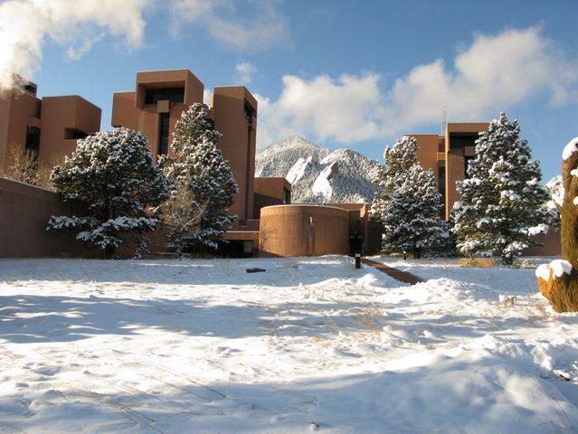
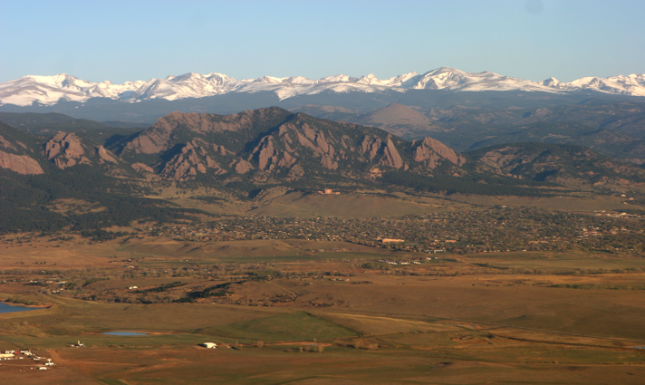
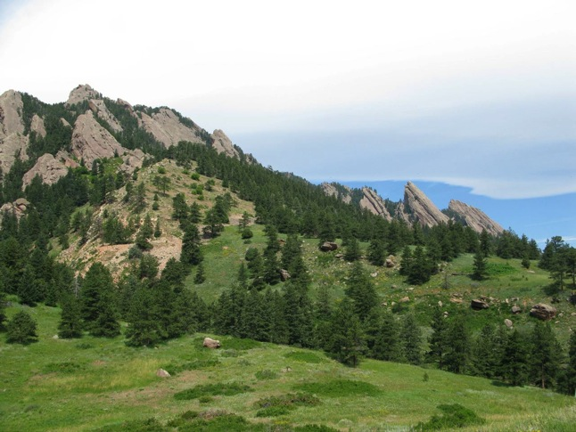
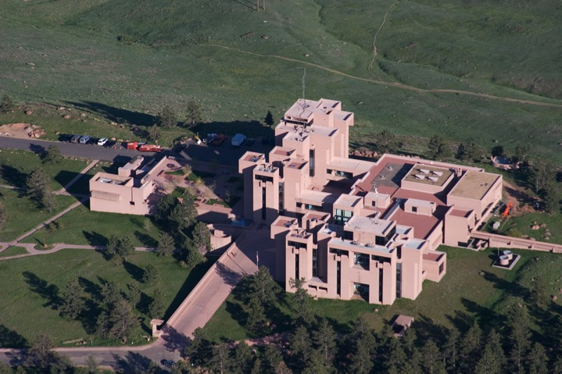
NCAR Mesa Lab and Flatirons · Boulder, Colorado

Slide 5
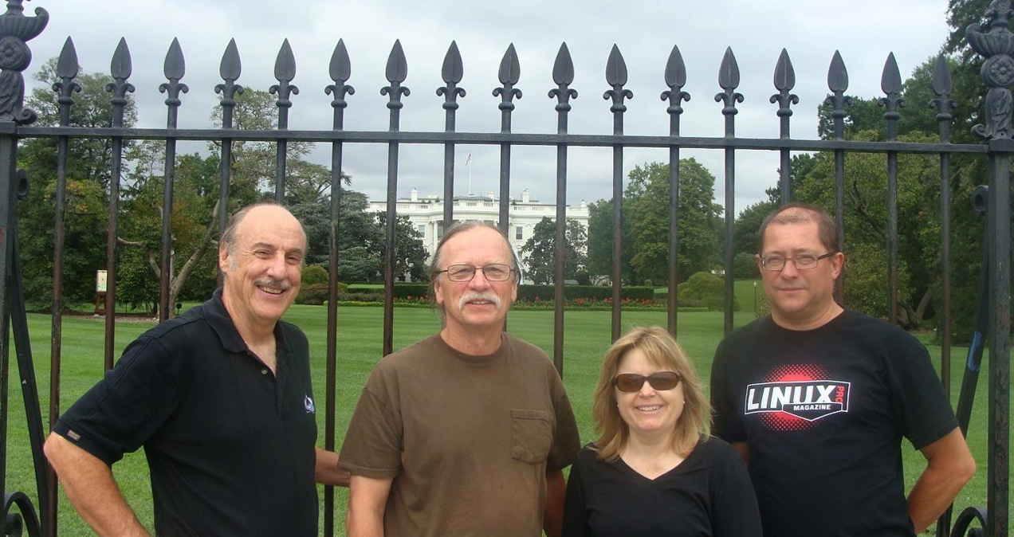


DAV team at NCAR/CISL/VETS
Dennis Shea
Science guy
Data expert
Trainer
Dave Brown
NCL Tech Lead
Everything
Mary Haley
Project lead
Trainer
Rick Brownrigg
Developer
Research
Wei Huang
Developer
Data Formats
Adam Phillips
Science guy
Graphical expert

Slide 6
DAV team • NCAR/CISL/VETS
Develop geoscientific analysis and visualization software in close collaboration with climate and weather scientists
Create extensive examples and documentation
Answer user questions on a daily (hourly!) basis
Provide hands-on training workshops 4-6x a year
Collaborate with outside groups and users to enhance software
Dennis Shea
Science guy
Data expert
Trainer
Dave Brown
NCL Tech Lead
Everything
Mary Haley
Project lead
Trainer
Rick Brownrigg
Developer
Research
Wei Huang
Developer
Data Formats
Adam Phillips
Science guy
Graphical expert

Slide 7
Peggy Wagner
Chaitanya Baru

Slide 8


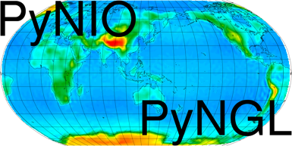





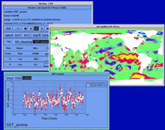


My three main areas of focus:
  describe data formats we work with
  provide an overview of the tools we develop or use, and projects we are involved with
  do some live demos of NCL
CDO
GRIB
OPeNDAP

Slide 9
Overview
Introductions
Audience survey
Introduction to data formats and metadata
Introduction to NCL
  File input/output – demo
  Computations – demo
  Visualizations – demo
NCL visualization gallery
Other projects and collaborations we are part of
User contributed software and projects
“No one tool does it all”
Challenges

Slide 10
Quick survey
What software do you currently use?
  Fortran, C, C++
  Scripting languages: Matlab, IDL, Python, R, Ruby, Java, NCL, etc
What types of data do you work with?
  ASCII
  Binary
  Excel
  Self-describing (NetCDF, HDF, Shapefile)
  Not sure

Slide 11
What is data science? Wikipedia
Data science incorporates varying elements and builds on techniques and theories from many fields, including math, statistics, data engineering, pattern recognition and learning, advanced computing, visualization, uncertainty modeling, data warehousing, and high performance computing with the goal of extracting meaning from data and creating data products. Data science is a novel term that is often used interchangeably with competitive intelligence or business analytics, although it is becoming more common. Data science seeks to use all available and relevant data to effectively tell a story that can be easily understood by non-practitioners.

Slide 12
To my team, data is a key driving force behind what we do
geo-referenced self-describing ASCII binary model data observational data regional global rectilinear curvilinear unstructured triangular mesh hexagonal quadrilateral moving nests nested grids complex grids
ragged arrays subsetting aggregation shifted poles lossy versus lossless conversion to other formats multiple files multi-dimensional missing values compressed large files really large files regridding interpolation chunking remote versus local parallel I/O

Slide 13
Who my team is, what we do
Introduction to data formats
DEMO – looking at data files
Overview of tools
Sample and real world visualizations
DEMO – creating NCL visualizations
Future plans

Slide 14
Data is critical to the science we do.
NCAR invests quite a bit of time and money researching ways to improve on all aspects of data creation, management, analysis, maintenance, visualization, integration, etc.
The tools we develop are tuned to the data formats used by climate and weather researchers.

Slide 15
Overview
Introductions
Audience survey
Introduction to data formats and metadata
Introduction to NCL
  File input/output – demo
  Computations – demo
  Visualizations – demo
NCL visualization gallery
Other projects and collaborations we are part of
User contributed software and projects
“No one tool does it all”
Challenges

Slide 16
Data formats
A data format is just a description of the type of a file
Types of data formats we mostly use:
  ASCII
  Binary
  Self-describing formats

Slide 17
Data formats: ASCII
Data usually organized in rows and columns
Pros
  Easy to look at: can use tools like Excel, Notepad, or any UNIX editor to look at files
  Can print it out
Cons
  Rather inefficient way to store data
  Hard to tell what kind of grid the data is on
  Can get unwieldy very quickly
  No one tool can read all ASCII files
  No standards
  Potential lack of descriptive info

Slide 18
Basic ASCII file
------------------------------------------------------------------
The 15 most populous nations. Data taken from Wikipedia
------------------------------------------------------------------
Location Population Date % of World
Population
World 7,103,500,000 August 9, 2013 100.00%
China 1,359,250,000 August 9, 2013 19.10%
India 1,232,320,000 August 9, 2013 17.30%
United States 316,418,000 August 9, 2013 4.45%
Indonesia 237,641,326 May 1, 2010 3.35%
Brazil 193,946,886 July 1, 2012 2.73%
Pakistan 183,903,000 August 9, 2013 2.59%
Nigeria 173,615,000 July 1, 2013 2.44%
Bangladesh 152,518,015 July 16, 2012 2.15%
Russia 143,400,000 April 1, 2013 2.02%
Japan 127,350,000 July 1, 2013 1.79%
Mexico 117,409,830 January 1, 2013 1.65%
Philippines 98,176,000 August 9, 2013 1.38%
Vietnam 88,780,000 July 1, 2012 1.25%
Ethiopia 86,613,986 July 1, 2013 1.22%
Egypt 83,661,000 January 1, 2013 1.18%

Slide 19
Sample CSV file (over 181,000 lines)
http://www.ncdc.noaa.gov/oa/ibtracs/
IBTrACS WMO: International Best Tracks Archive for Climate Stewardship -- WMO DATA ONLY -- Version: v03r04
Serial_Num,Season,Num,Basin,Sub_basin,Name,ISO_time,Nature,Latitude,Longitude,Wind(WMO),Pres(WMO),Center,Wind(WMO) Percentile,Pres(WMO) Percentile,Track_type
N/A,Year,#,BB,BB,N/A,YYYY-MM-DD HH:MM:SS,N/A,deg_north,deg_east,kt,mb,N/A,%,%,N/A
1848011S09080,1848,02, SI, MM,XXXX848003,1848-01-11 06:00:00, NR, -8.60, 79.80, 0.0, 0.0,reunion,-100.000,-100.000,main
1848011S09080,1848,02, SI, MM,XXXX848003,1848-01-12 06:00:00, NR, -9.00, 78.90, 0.0, 0.0,reunion,-100.000,-100.000,main
1848011S09080,1848,02, SI, MM,XXXX848003,1848-01-13 06:00:00, NR,-10.40, 73.20, 0.0, 0.0,reunion,-100.000,-100.000,main
1848011S09080,1848,02, SI, MM,XXXX848003,1848-01-14 06:00:00, NR,-12.80, 69.90, 0.0, 0.0,reunion,-100.000,-100.000,main
1848011S09080,1848,02, SI, MM,XXXX848003,1848-01-15 06:00:00, NR,-13.90, 68.90, 0.0, 0.0,reunion,-100.000,-100.000,main
1848011S09080,1848,02, SI, MM,XXXX848003,1848-01-16 06:00:00, NR,-15.30, 67.70, 0.0, 0.0,reunion,-100.000,-100.000,main
1848011S09080,1848,02, SI, MM,XXXX848003,1848-01-17 06:00:00, NR,-16.50, 67.00, 0.0, 0.0,reunion,-100.000,-100.000,main
1848011S09080,1848,02, SI, MM,XXXX848003,1848-01-18 06:00:00, NR,-18.00, 67.40, 0.0, 0.0,reunion,-100.000,-100.000,main

Slide 20
Data formats: binary
Examples: “Fortran sequential”, “Fortran direct”
Pros
  Usually smaller file sizes than ASCII
Cons
  Not easily portable across computers – need to know “big endian” versus “little endian”
  Need special program to look at binary data
  What happens if you lose description of what’s on the file? You won’t know how to read it.
  No standards

Slide 21
Data formats: self-describing
Self-describing data is data that has descriptive data (“metadata”) associated with it
Metadata is optional, but highly useful
Metadata can include information about the file itself and about the variables on the file
Metadata generally consists of three features:
  Attributes (descriptive information about file or variables)
  Named dimensions (names for dimensions in arrays)
  Coordinate arrays (one-dimensional arrays that indicate lat/lon locations, levels, time, etc, of data points)

Slide 22
Data formats: self-describing
Pros
  Well-written files have all the information you need, hence easier to share with others
  You can query what’s on the file before reading the whole file
  You can easily ask for subsets of data:
    “Give me all the temperature values for this lat/lon range”
Cons
  Files can get large if you have lots of variables and/or lots of metadata
  Some standards, but not always adopted

Slide 23
  CF (“Climate and Forecast”) Metadata Conventions http://cf-pcmdi.llnl.gov
Mainly for climate and weather data
Promotes sharing of files
Metadata for spatial and temporal quantities
Designed with NetCDF in mind
Facilitates building applications with extraction, analysis, and display capabilities
Wide variety of groups have adopted this standard

Slide 24
Metadata: global attributes
Information about the file itself
Some global attributes recommended by
“CF conventions” document:
  “title”: one-line description of what’s in the file
  “institution”: where original data file was created
  “source”: method used to produce the data file
  “history”: history of mods to the data, timestamps
  “references”: publications, web-based references for data
  “comment” – miscellaneous information
  “Climate and Forecast” (CF) Metadata conventions:
  http://cf-pcmdi.llnl.gov

Slide 25
Metadata: variable attributes
Information about each variable
Some variable attributes recommended by
CF conventions:
  “units”: one-line description of what’s in data
  “long_name”: a long descriptive name
  “standard_name”: shorter name with no spaces
  “_FillValue”: special attribute containing value that represents missing values (-999, 1e30, etc)
  “scale_factor” and “add_offset”: used for packing data, making it more compact

Slide 26
Metadata: dimension names
Naming each dimension of an array
For example, for a 4-dimensional array, instead of:
“This variable is dimensioned 1 x 30 x 96 x 144”
Use dimension names:
“This variable is dimensioned time x lev x lat x lon (1 x 30 x 96 x 144)”
Not really any conventions for dimension names, but “time”, “lev”, “lat”, “lon” are very common

Slide 27
Metadata: coordinate variables
Sometimes called “coordinate arrays”
Gives the coordinate values for a particular dimension of an array
Is one-dimensional with same length as the dimension it represents.
Has the same name as dimension it represents
Its name is the same as the dimension name
Again, not really any conventions, they tie in very closely with dimension and variable names.

Slide 28
Some self-describing data formats
NetCDF (Network Common Data Form)
  Most commonly used in climate sciences
  http://www.unidata.ucar.edu/software/netcdf/
HDF (Hierarchical Data Format)
  Used by NASA
  Common format for satellite data
  http://www.hdfgroup.org

Slide 29


More self-describing data formats
GRIB (Gridded Binary)
  Historical and forecast weather data
  WMO standard
  Highly compressed
  Can be complicated to read, requires supplemental files
Shapefiles
  ESRI/GIS format
  Can be points, lines, polygons
  Example: population, roads, country boundaries, election data, airport locations

Slide 30
What do we do with all this data?
Look at it (print values, look at)
Convert to another format
Do calculations on it
Visualize it
Compare to other data, like observational data
Enhance or fix it (write new files)

Slide 31
Overview
Introductions
Audience survey
Introduction to data formats and metadata
Introduction to NCL
  File input/output – demo
  Computations – demo
  Visualizations – demo
NCL visualization gallery
Other projects and collaborations we are part of
User contributed software and projects
“No one tool does it all”
Challenges

Slide 32
Overview of the
NCAR Command Language
This is the main tool we develop and support
DOI: http://dx.doi.org/10.5065/D6WD3XH5

Slide 33

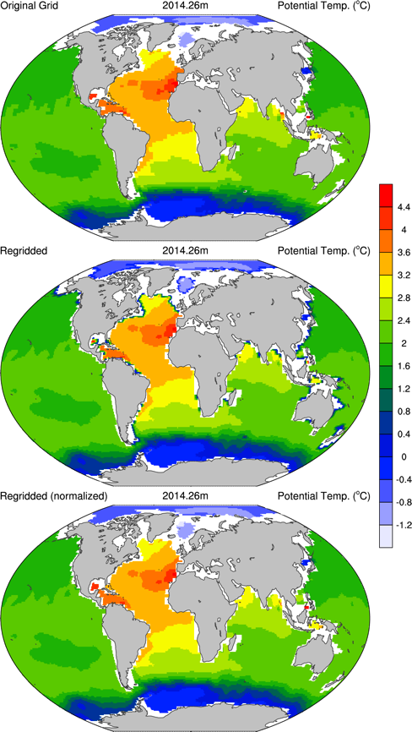
NCAR Command Language (NCL)
A scripting language tailored for the analysis and visualization of geoscientific data
Simple, robust file input and output
Hundreds of analysis (computational) functions
Visualizations (2D) are publication quality and highly customizable
Users range from grad students doing individual research to programmers in scientific organizations working on large scale projects
UNIX binaries & source available, free
Extensive website, regular workshops
http://www.ncl.ucar.edu/

Slide 34

NCL is known as a “community” tool
Open source and free, runs on laptops
User driven: developed in close collaboration
with researchers
Use of other open source software (NetCDF, HDF4, HDF5, Udunits-2, cdtime, cairo, ESMF, g2clib, a number of C/Fortran analysis libraries)
World-wide contributions are accepted and encouraged
Well-supported
  Knowledgeable and quick consulting
  Users contribute to consulting and code
  Hundreds of examples, many “real world”
  Quick turn-around of most bug fixes
  User-tailored training with hands-on labs

Slide 35

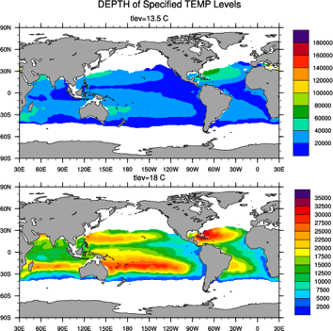
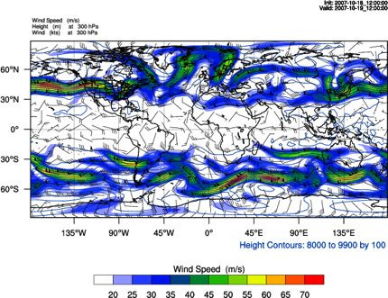
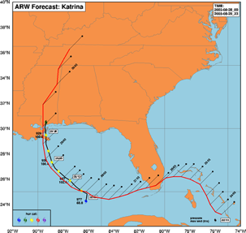
Collaboration with modelers
CESM (Community Earth System Model) – a computer-based general-circulation model that uses mathematical formulas to recreate the chemical and physical processes that drive Earth's climate.
WRF (Weather Research and Forecasting Model) - a next-generation mesocale numerical weather prediction system designed to serve both operational forecasting and atmospheric research needs.

Slide 36
Types of research - reported
DTV propagation analysis
IPCC research
MARS cam
NASA precipitation missions
air quality research
air science
air ventilation assessment
air-sea interaction
aircraft icing research
animal disease modeling
applied insurance
astronomy
atmospheric research
atmospheric teleconnections
atomic energy
aviation forecasting
battlespace environment modeling
bauxite refinery
beam physics
biofuels modeling
biogeochemistry
bird migration
black hole
bluetongue transmission risk
borehole temperatures
bushfire mitigation
carbon cycle modelling
cell motility
climates of extrasolar planets
cloud parameterization
dimethylsulphoniopropionate
disaster prevention
drought predicting
dust
earth magnetic field
ecosystem model
electric power
extreme weather events
fire weather forecasting
fish climate
flight experiments
fluid dynamics
fog forecast
forest productivity
fusion plasma
geophysics support
glacial climate studies
greenhouse modeling
heat balance
heavy rainfall
historical weather maps
humidity projections
hurricanes
hydrology modeling
improvement of dairy cattle
insect research
ionospheric studies
lake effect snow storms
larval transport
lightning research
magnetic resonance imaging
magnetohydrodynamics
mapping epidemiological data
marine studies
martian climate
material stress and strain
mercury deposits
meso-gamma simulations
microbiology
microburst outflows
modeling of stem cells
molecular physics
monsoon studies
morphodynamics, long term
neuron model
noble gas sampling
ocean biology
ocean eddy research
oceanography
optical data, display of
ozone
paleoclimate studies
particle orbit
physics
planetary exploration data
plasma simulation
polar research
radiation risk research
radiowave propagation
real-time ocean forecasting
remote sensing
renewable energy
rice production
road weather research
satellite image processing
scattometer studies
sea breeze simulation
sea ice studies
sediment transport research
ships in waves simulations
snake bites in Brazil
snow data assimilation
soaring conditions for gliders
social sciences
soil moisture
solar irrigation change
space geodesy
space weather
spread of farming & milk drinking
star modeling
station data plots
storm surge analysis
storms, forecasting of
surf charts
teaching
tokamak modeling
tornado climatology
transport of aerosols from oil
facilities
tropopsheric air pollution
turbulent particle-laden flow
typhoon research
urban flood demonstration
urban meteorology
volcanic signals in ice cores
water resources and irrigation
water vapor feedback
weather display
weather forecasting for sailboats
weather modification
wildfire simulation
wildlife conservation and restoration program
wind energy
wind erosion
wind forecasting for wind surfers
wind resources

Slide 37

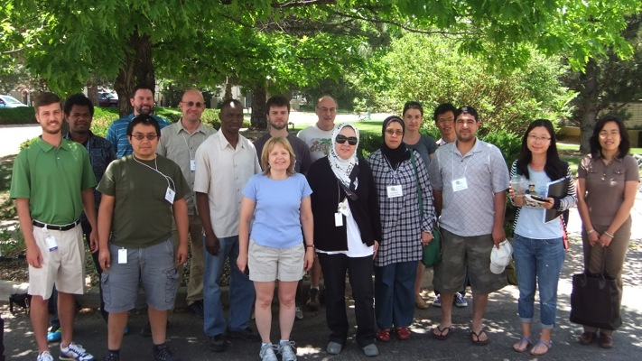

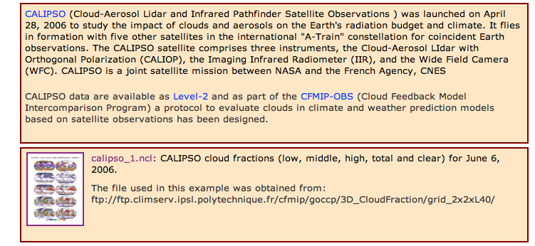
How we reach our users
Workshops
One-on-one correspondence with users
Hundreds of website examples
http://www.ncl.ucar.edu/Applications/
Active email lists
I am regridding a 12km by 12km lambert conical conformal grid of sparse emissions over the U.S. To a 1/2 by 2/3 degree grid over the same domain. If I choose the grid corners to be rounded to zero decimal places, I get a slightly different answer in my final emissions than if I round the grid corner to 2 decimal places which is actually slightly (1%) less than the original emissions. Why would this occur, and what is 'best practices' in choosing the grid corners for this scenario?

Slide 38
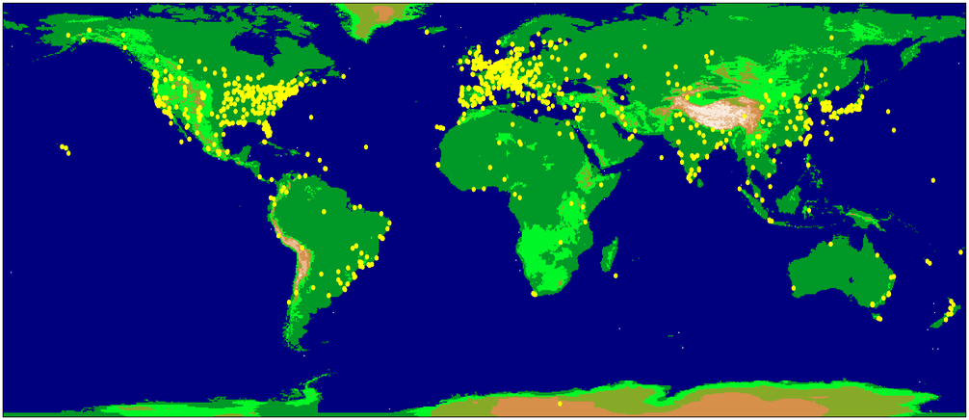
Metrics and scope of software usage
  16,000+ registered users in over 140 countries
  (count started in early 2005)
  Average of 1800 downloads a month
  Average of 340 emails a month on email list (includes responses)

Slide 39
Overview
Introductions
Audience survey
Introduction to data formats and metadata
Introduction to NCL
  File input/output – demo
  Computations – demo
  Visualizations – demo
NCL visualization gallery
Other projects and collaborations we are part of
User contributed software and projects
“No one tool does it all”
Challenges

Slide 40
NCL’s file input and output
One function reads all supported data formats:
  NetCDF 3/4, GRIB 1 and 2, HDF4, HDF5,
  HDF-EOS2, HDF-EOS5, Shapefile
  Writes NetCDF 3/4 (classic) and HDF4
NCL variables have same features as self-describing data formats
That is, the variables can have:
  Attributes (“units”, “long_name”, “_FillValue”)
  Dimension names (“time”, “lev”, “lat”, “lon”)
  Coordinate arrays (1D arrays of coordinate points)
OPeNDAP-enabled
ASCII, binary (read and write)

Slide 41
DEMO #1
Looking at various data formats with NCL
Simple NetCDF file
WRF output file (NetCDF)
GRIB file
HDF5

Slide 42
Examining contents of a file same for HDF, GRIB, shapefile
NCL script: “read.ncl”
f = addfile(“cam35.h0.0008-07.nc”,”r”)
print(f)
PyNIO script: “read.py”
import Nio
f = Nio.open_file(“cam35.h0.0008-07.nc”)
print(f)
On the UNIX command line
% ncl read.ncl
% python read.py
% ncl_filedump cam35.h0.0008-07.nc

Slide 43
filename: cam35.h0.0008-07
path: cam35.h0.0008-07.nc
file global attributes:
Conventions : CF-1.0
source : CAM
case : seqnoflxave06_cam3_5_24
title :
logname :
host :
Version : $Name$
revision_Id : $Id$
. . .
dimensions:
ncl_scalar = 1
lat = 96
lon = 144
slat = 95
slon = 144
lev = 26
ilev = 27
. . .
float PCONVB ( time, lat, lon )
units : Pa
long_name : convection base pressure
cell_method : time: mean
float PCONVT ( time, lat, lon )
units : Pa
long_name : convection top pressure
cell_method : time: mean
float PHIS ( time, lat, lon )
units : m2/s2
long_name : Surface geopotential

Slide 44
Overview
Introductions
Audience survey
Introduction to data formats and metadata
Introduction to NCL
  File input/output – demo
  Computations – demo
  Visualizations – demo
NCL visualization gallery
Other projects and collaborations we are part of
User contributed software and projects
“No one tool does it all”
Challenges

Slide 45
NCL’s computational analyses
Array-based math (no need to loop across dimensions) – similar to Matlab, Python, IDL
Hundreds of computational functions
  Spherical harmonics, empirical orthogonal functions (EOFs)
  Scalar and vector regridding
  Interpolation
  Climatologies
  Functions specific to CESM and WRF models
Many tailored to climate and weather
Some are highly-specialized
Most handle missing data
Can call C and Fortran routines from NCL and PyNGL
Many contributions from users, they drive priorities

Slide 46
DEMO #2
Writing NCL scripts to read data and do simple computations

Slide 47
Overview
Introductions
Audience survey
Introduction to data formats and metadata
Introduction to NCL
  File input/output – demo
  Computations – demo
  Visualizations – demo
NCL visualization gallery
Other projects and collaborations we are part of
User contributed software and projects
“No one tool does it all”
Challenges

Slide 48
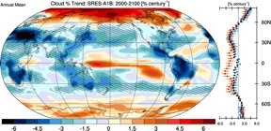
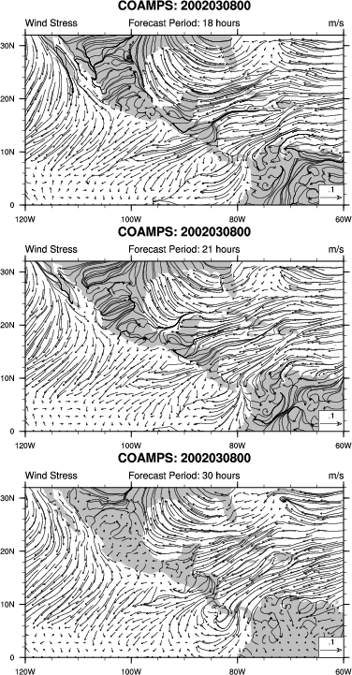
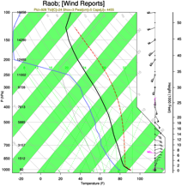
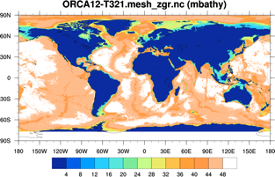
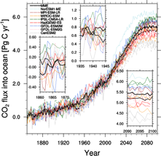
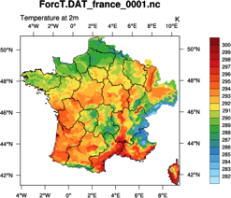
NCL Visualizations
High-quality and customizable visualizations
Contours, XY, vectors, streamlines
Maps with common map projections
Handles data on regular and irregular grids,
triangular meshes
Specialized scripts for climate diagnostics,
skew-T, wind roses, histograms,
Taylor diagrams, panels, bar charts
High-level interfaces: simplifies graphics code
Over 1,400 visualization “options”

Slide 49
DEMO #3
Writing NCL scripts to do simple visualizations
Using an “ERAI” NetCDF file
ERA-Interim is an improved atmospheric model and assimilation system from those used in ERA-40.
http://climatedataguide.ucar.edu/reanalysis/era-interim
ERA40 is a second generation reanalysis. It is the first reanalysis to directly assimilate satellite radiance data. Cloud Motion Winds are also used. The result is better circulation over the tropics and southern hemisphere.

Slide 50
Simple black and white graphic
f = addfile(“erai_1989-2009.mon.msl_psl.nc”,”r”)
p = f->SLP ; (time,lat,lon)
; ( 252,121,240)
printVarSummary(p) ; information about variable
wks = gsn_open_wks("ps",”pressure") ; open a PostScript file
plot = gsn_csm_contour_map(wks,p(0,:,:),False) ; default plot
Variable: p
Type: float
Total Size: 29272320 bytes
7318080 values
Number of Dimensions: 3
Dimensions and sizes: [time | 252] x [latitude | 121] x [longitude | 240]
Coordinates:
time: [780168..963504]
latitude: [90..-90]
longitude: [ 0..358.5]
Number Of Attributes: 4
_FillValue : 1e+20
units : hPa
long_name : Mean sea level pressure
missing_value : 1e+20
“printVarSummary(p)” output

Slide 51
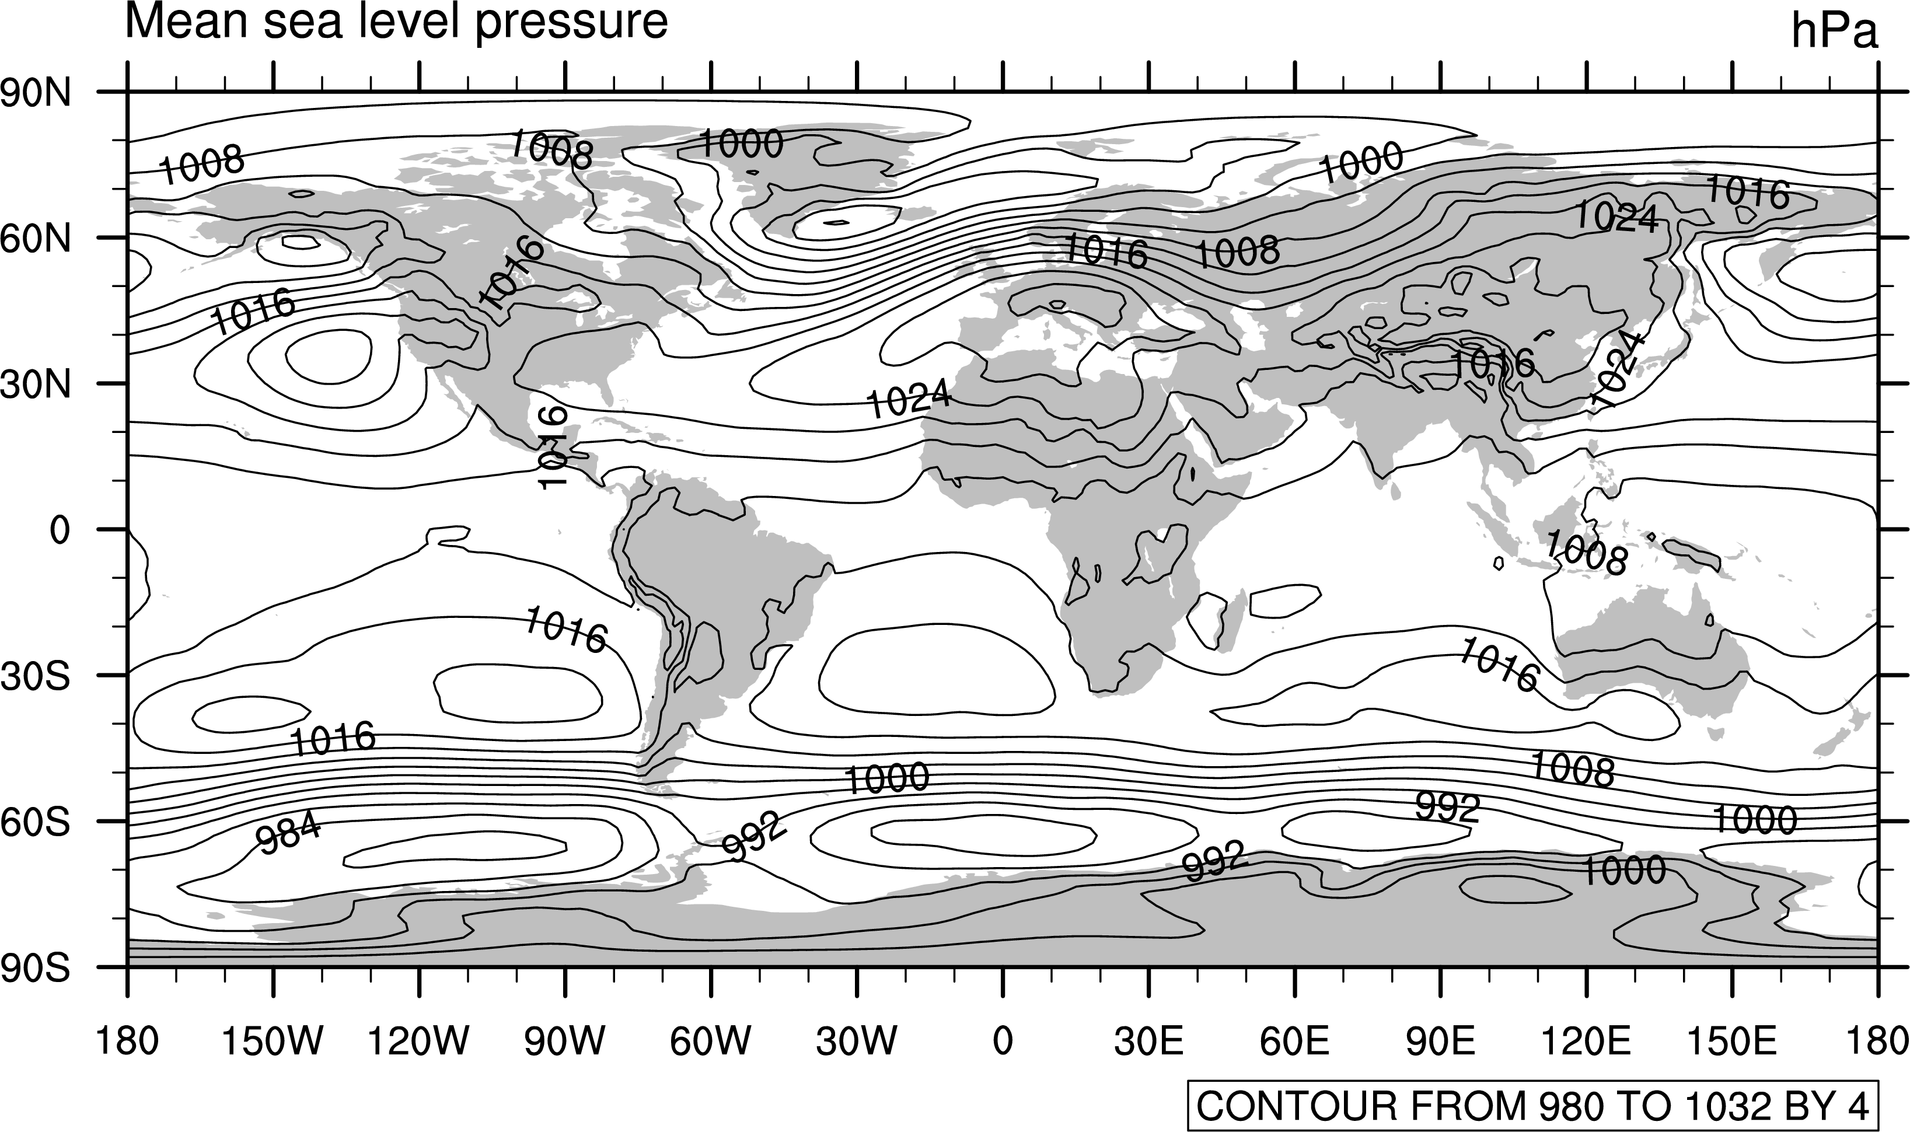
Simple black and white graphic

Slide 52
Calculate & plot a January monthly mean
f = addfile("erai_1989-2009.mon.msl_psl.nc","r") ; open file
p = f->SLP ; (time,lat,lon)
; ( 252,121,240)
pJan = dim_avg_n_Wrap(p(::12,:,:), 0) ; Jan mean over all years
printVarSummary(pJan) ; 121 x 240
wks = gsn_open_wks(“png”,”jan”) ; open png file
res = True ; visualization options
res@cnFillOn = True ; color on
res@tiMainString = "ERAI: 1989-2009: January"
plot = gsn_csm_contour_map(wks,pJan,res)

Slide 53
Calculate & plot a January monthly mean (cont’d)
Variable: pJan
Type: float
Total Size: 116160 bytes
29040 values
Number of Dimensions: 2
Dimensions and sizes: [latitude | 121] x [longitude | 240]
Coordinates:
latitude: [90..-90]
longitude: [ 0..358.5]
Number Of Attributes: 5
missing_value : 1e+20
long_name : Mean sea level pressure
units : hPa
_FillValue : 1e+20
average_op_ncl : dim_avg_n over dimension(s): time
Output from “print”

Slide 54
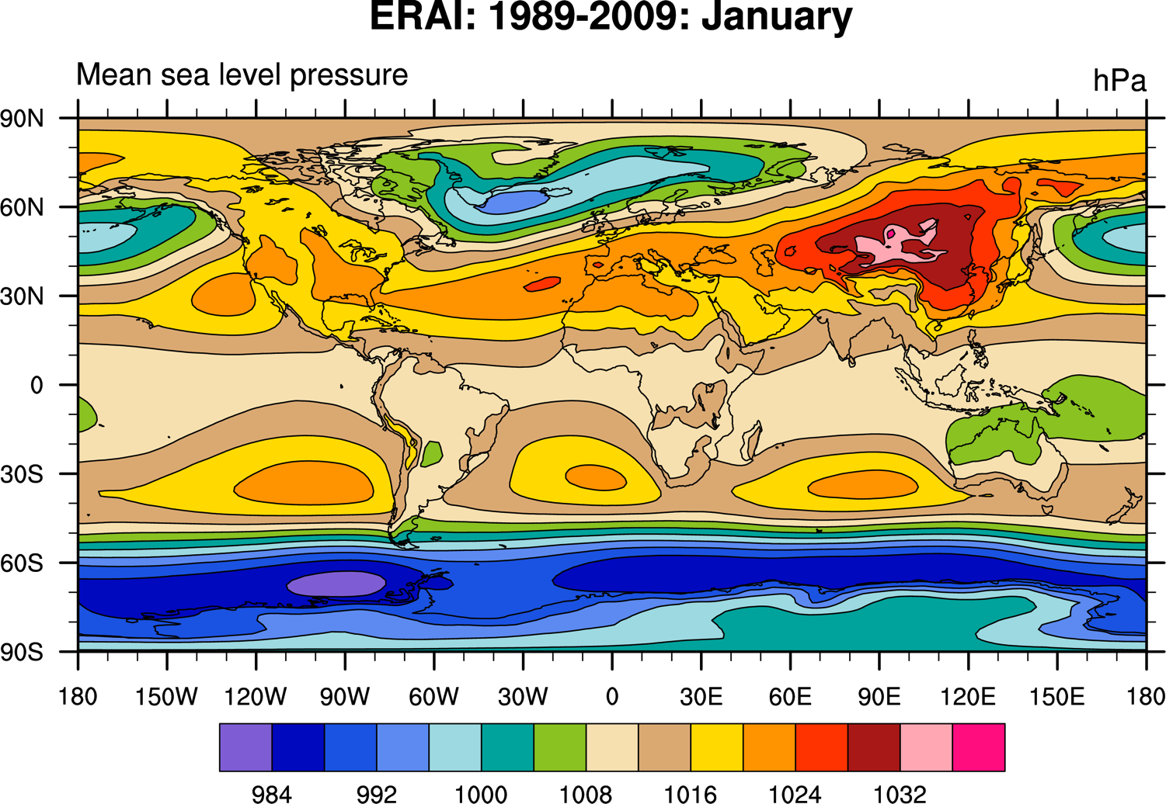

Slide 55
Calculating EOFS, writing a NetCDF file
load "$NCARG_ROOT/lib/ncarg/nclscripts/csm/gsn_code.ncl"
load "$NCARG_ROOT/lib/ncarg/nclscripts/csm/gsn_csm.ncl"
load "$NCARG_ROOT/lib/ncarg/nclscripts/csm/contributed.ncl"
f = addfile("erai_1989-2009.mon.msl_psl.nc","r") ; open file
p = f->SLP(::12,{0:90},:) ; (21,61,240)
w = sqrt(cos(0.01745329*p&latitude) ) ; weights[*]
wp = p*conform(p, w, 1) ; wp[*][*][*]
copy_VarCoords(p, wp)
x = wp(latitude|:,longitude|:,time|:) ; reorder data
neof = 3
eof = eofunc_Wrap(x, neof, False)
eof_ts = eofunc_ts_Wrap (x, eof, False)
printVarSummary( eof ) ; examine EOF variables
printVarSummary( eof_ts )
; Create netCDF: no define mode [simple approach, can be slow]
system("/bin/rm -f EOF.nc") ; remove any pre-existing file
fout = addfile("EOF.nc", "c") ; new netCDF file
fout@title = "EOFs of SLP 1989-2009"
fout->EOF = eof
fout->EOF_TS = eof_ts

Slide 56
Variable: eof
Type: float
Total Size: 175680 bytes
43920 values
Number of Dimensions: 3
Dimensions and sizes: [evn | 3] x [latitude | 61] x [longitude | 240]
Coordinates:
evn: [1..3]
latitude: [ 0..90]
longitude: [ 0..358.5]
Number Of Attributes: 6
eval_transpose : ( 47.2223, 32.42917, 21.44406 )
eval : ( 34519.5, 23705.72, 15675.61 )
pcvar : ( 26.83549, 18.42885, 12.18624 )
matrix : covariance
method : transpose
_FillValue : 1e+20
Variable: eof_ts
Type: float
Total Size: 252 bytes
63 values
Number of Dimensions: 2
Dimensions and sizes: [evn | 3] x [time | 21]
Coordinates:
evn: [1..3]
time: [780168..955488]
Number Of Attributes: 3
ts_mean : ( 3548.64, 18262.12, 20889.75 )
matrix : covariance
_FillValue : 1e+20
“printVarSummary” output

Slide 57
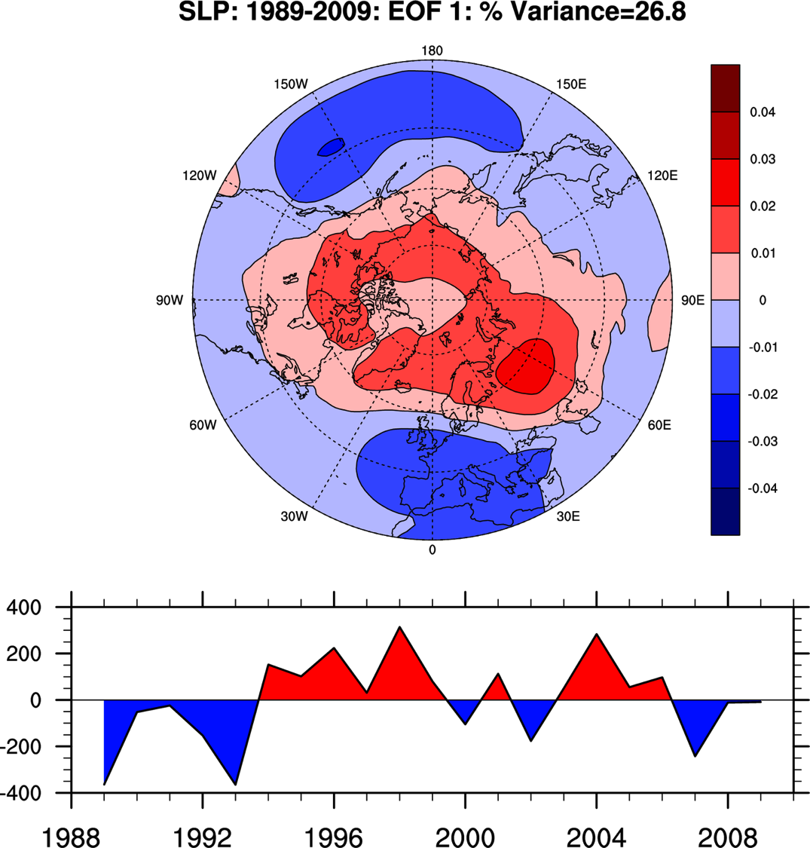

Slide 58
POP scalar example: ‘thinning’ array to speed up plotting
load "$NCARG_ROOT/lib/ncarg/nclscripts/csm/gsn_code.ncl"
load "$NCARG_ROOT/lib/ncarg/nclscripts/csm/gsn_csm.ncl"
load "$NCARG_ROOT/lib/ncarg/nclscripts/csm/contributed.ncl"
begin
fili = "PHC2_” + VAR + "_tx0.1v2.JAN.nc"
f = addfile(diri + fili,"r")
; for demo, just 1st time and level
nSkip = 2 ; make faster ... nSkip >1
x = f->SALT(0,0,::nSkip,::nSkip) ; x(nlat,mlon) (2400 x 3600)
x@lat2d = f->TLAT(::nSkip,::nSkip) ; 2D curvilinear coordinate arrays
x@lon2d = f->TLONG(::nSkip,::nSkip)
;=================================================
; Create contours over a map
;=================================================
wks = gsn_open_wks("ps","PHC2_"+VAR+"_"+nSkip) ; open a PS file
gsn_define_colormap(wks,"amwg") ; choose colormap
res = True
res@cnFillOn = True ; turn on color
res@cnFillMode = "RasterFill" ; AreaFill, CellFill
res@cnLinesOn = False ; turn off contour lines
res@gsnSpreadColors = True ; use full colormap
res@gsnSpreadColorEnd = -2 ; don't use gray for contours
res@gsnAddCyclic = True ; force cyclic value
res@mpFillDrawOrder = "PostDraw" ; do map fill last
res@mpLandFillColor = “LightGray" ; color of land
plot = gsn_csm_contour_map(wks,x,res)
end

Slide 59
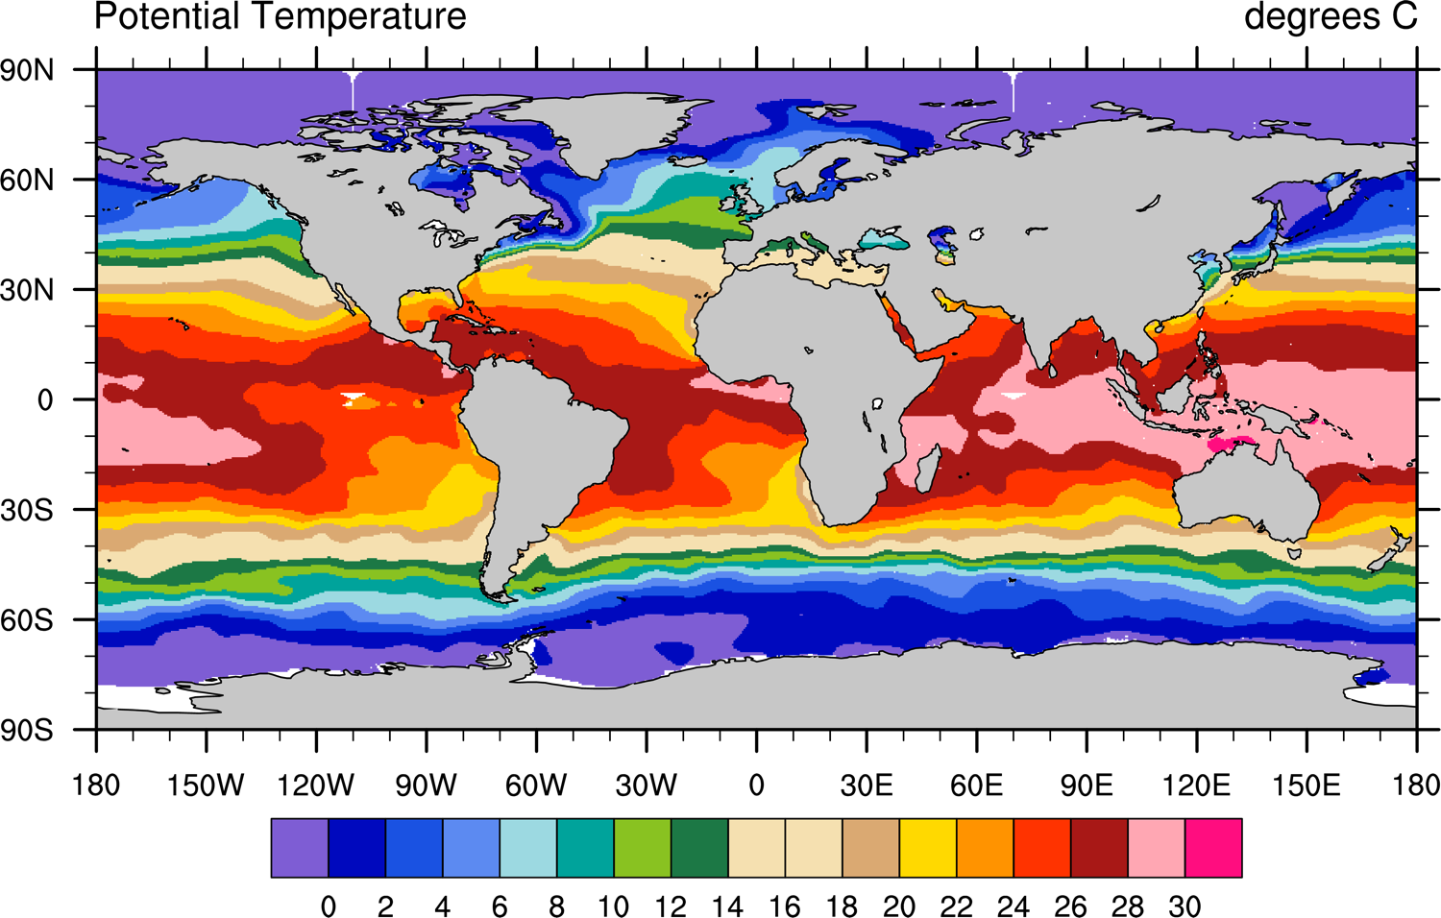

Slide 60
Overview
Introductions
Audience survey
Introduction to data formats and metadata
Introduction to NCL
  File input/output – demo
  Computations – demo
  Visualizations – demo
NCL visualization gallery
Other projects and collaborations we are part of
User contributed software and projects
“No one tool does it all”
Challenges

Slide 61
NCL Visualizations
Hundreds of example and real world scripts available:
http://www.ncl.ucar.edu/Applications/
Most visualizations that follow are taken from above URLs and have scripts you can download to generate them.

Slide 62
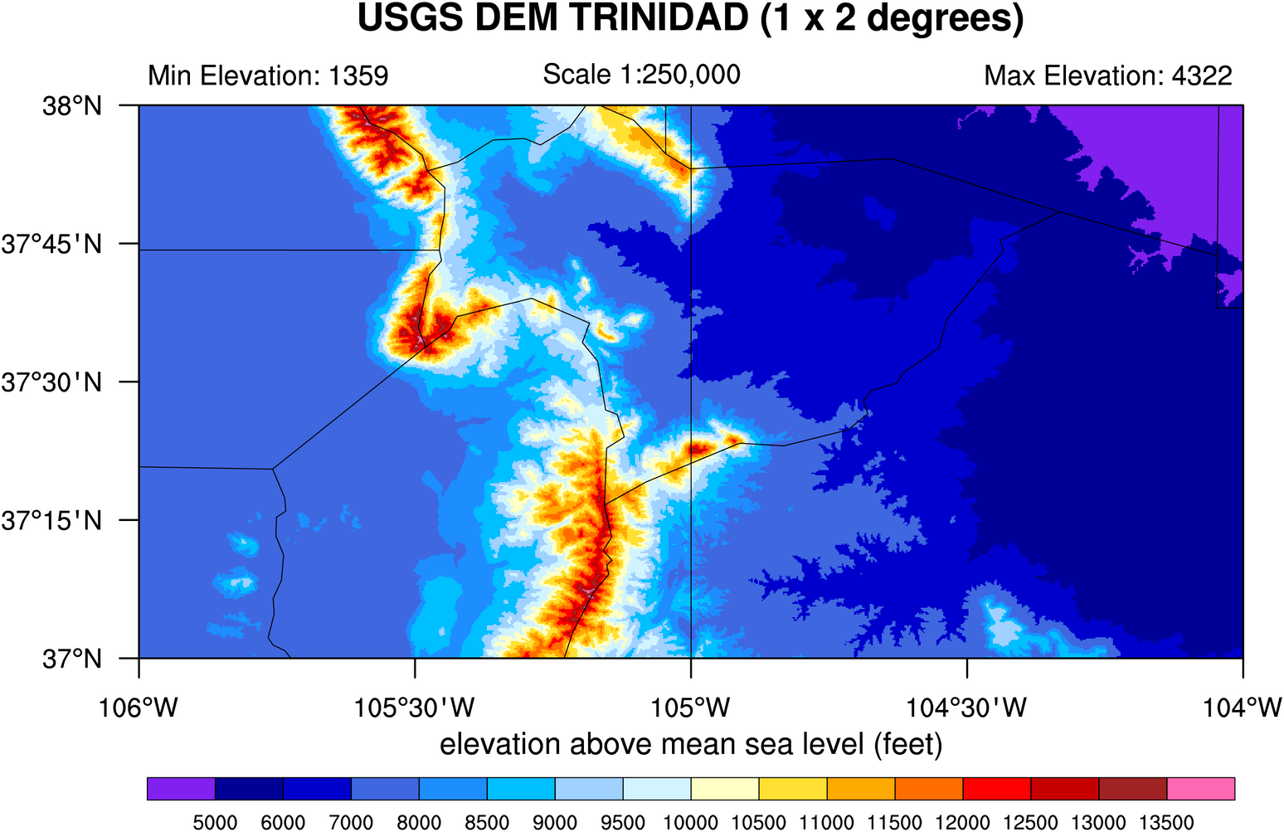
Raster contours of terrain data over southern Colorado
Mark Stevens, NCAR

Slide 63
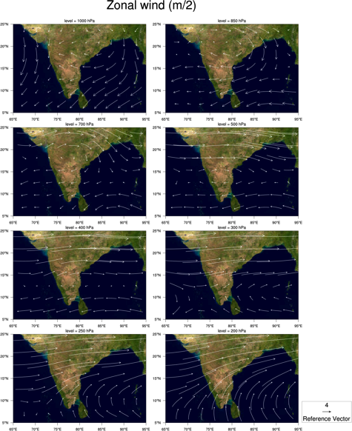
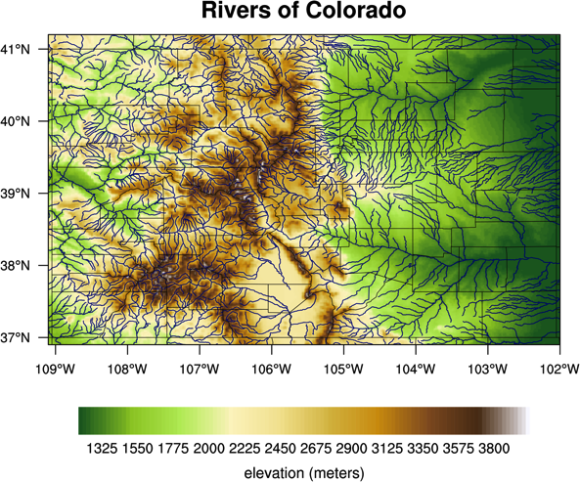
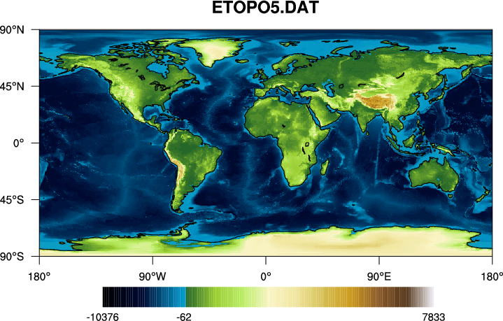
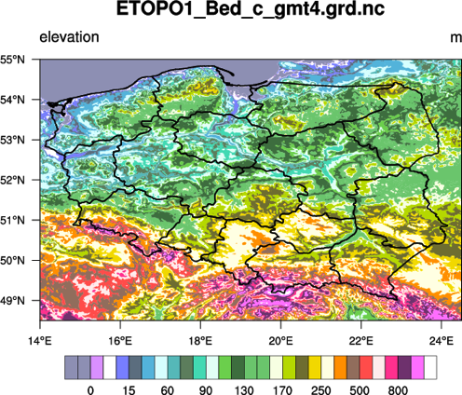
Topographic images and data from various sources
NASA JPEG image
http://www.nws.noaa.gov/geodata/catalog/hydro/html/rivers.htm
http://www.ngdc.noaa.gov/mgg/global/relief/ETOPO5/TOPO/ETOPO5/
http://www.netgis.geo.uw.edu.pl
http://www.nws.noaa.gov/geodata/catalog/hydro/html/rivers.htm

Slide 64
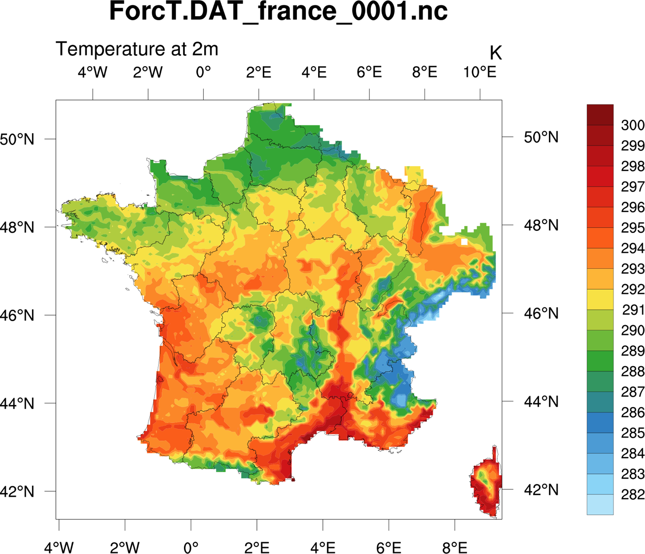
SAFRAN model file provided by Clotilde Dubois of Meteo-France

Slide 65
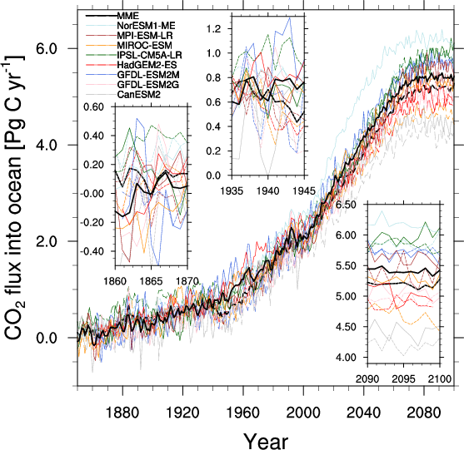
Hongmei Li of Max Planck Institute for Meteorology in Hamburg

Slide 66
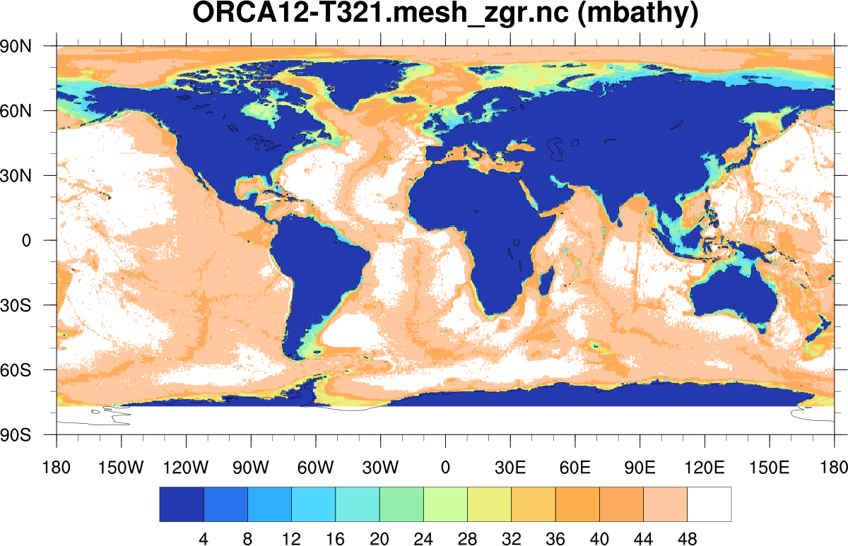
Bathymetry from an ORCA12 grid file provided by Romain Bourdalle-Badie of Mercator Ocean. The variable is dimensioned 3059 x 4322

Slide 67
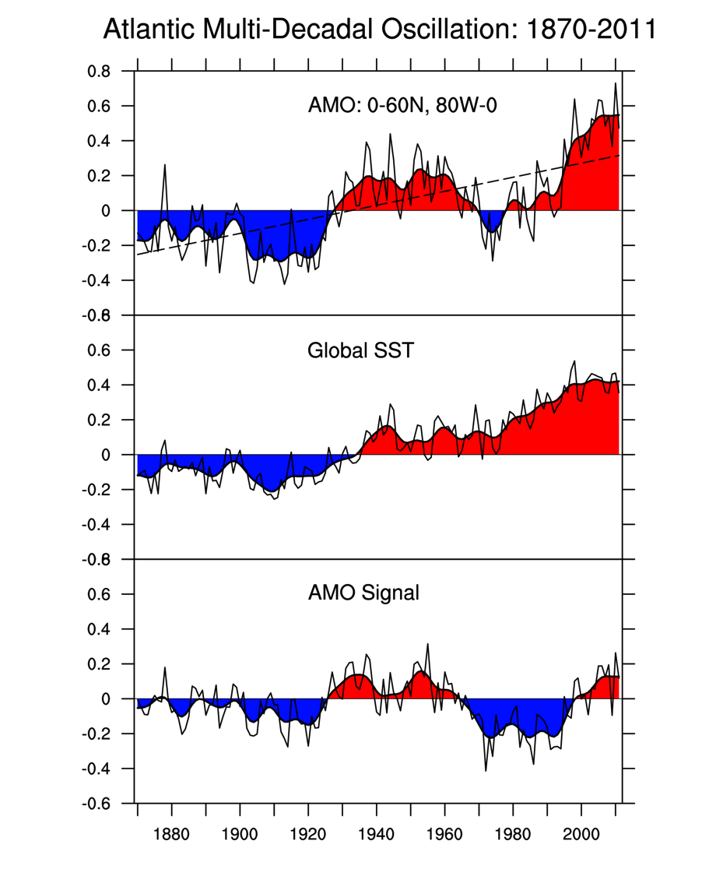
Atlantic multi-decadal oscillation index
Dennis Shea, NCAR/CGD

Slide 68
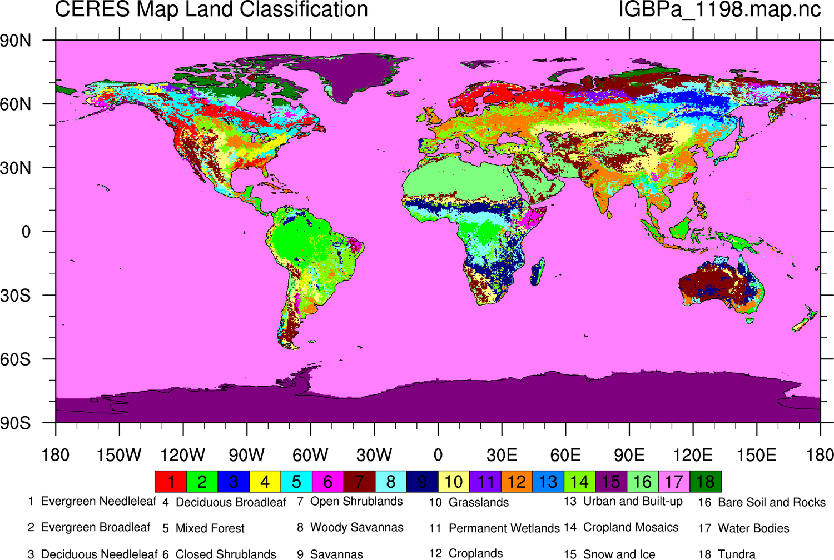
IGBP vegetation classification is derived from the CERES 10-min Map Land Classification.

Slide 69
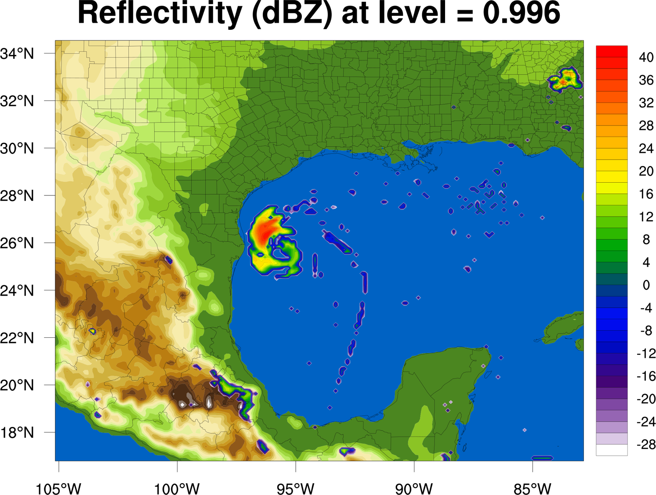
Sample plot of WRF data, Mary Haley

Slide 70
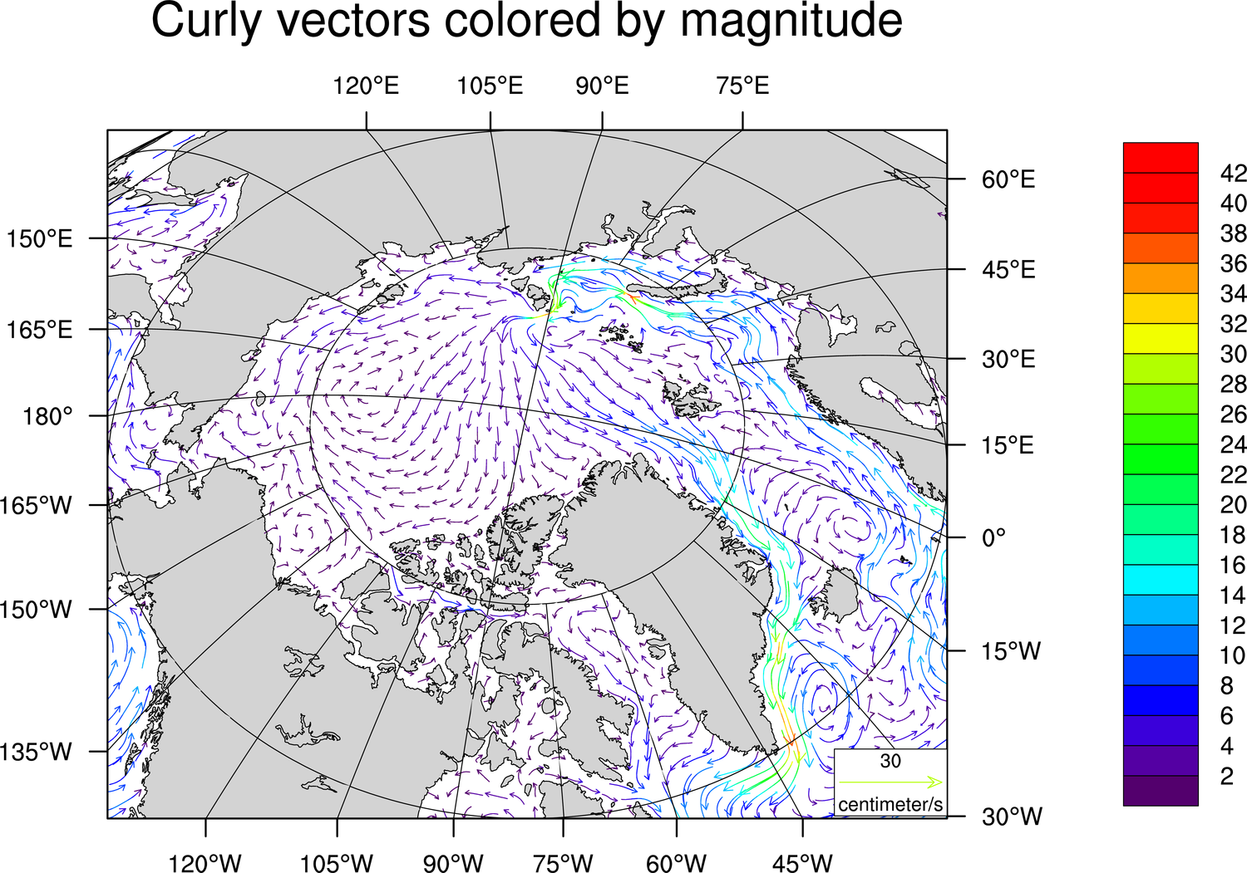
Dave Brown, NCAR/CISL

Slide 71
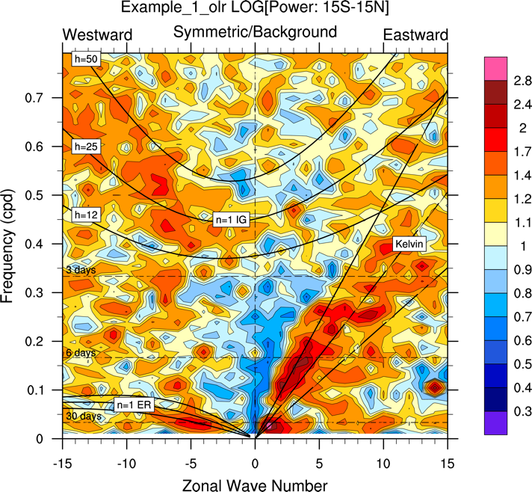
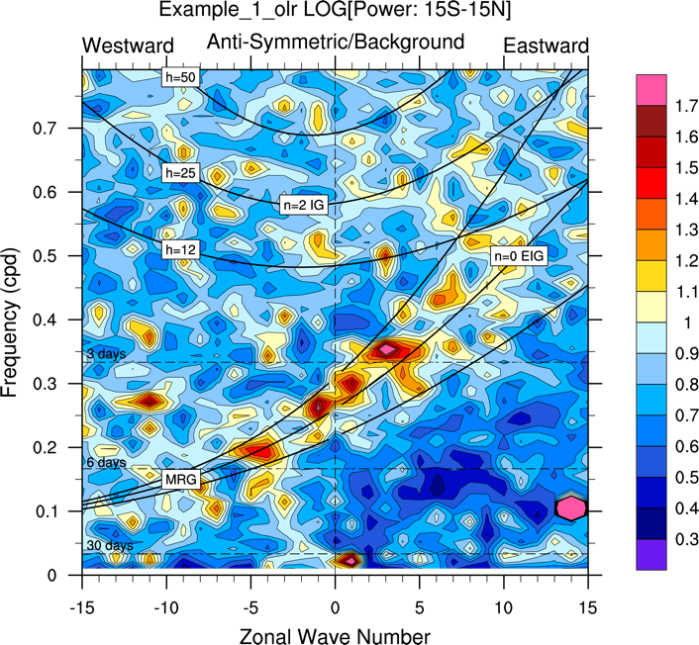
Wheeler-Kiladis space-time spectra
The data used were from ERA40 1999-2001 on a T85 grid. The original data were at a sampling rate of 4x per day (every 6 hours). The sampling rate was reduced (decimated) to 2x per day (every 12 hours). This may be needed if memory is a problem. Courtesy Dennis Shea, NCAR/CGD

Slide 72
NCL visualizations for specialized data
CALIPSO: Cloud-Aerosol Lidar & Infrared Pathfinder Satellite Observations
CloudSat: Cloud Vertical
DAYMET: Daily surface weather and climatologies
GPCP: Global Precipitation Climatology Project
SSMI Ocean Product Suite
Scripts developed by Dennis Shea, NCAR/CGD
Co-author of Climate Data Guide: http://climatedataguide.ucar.edu
“The Climate Data Guide provides the key insights needed to select the data that best align with your goals, including critiques of data sets by experts from the research community. We invite you to learn from their insights and share your own.”
http://www.ncl.ucar.edu/Applications/

Slide 73
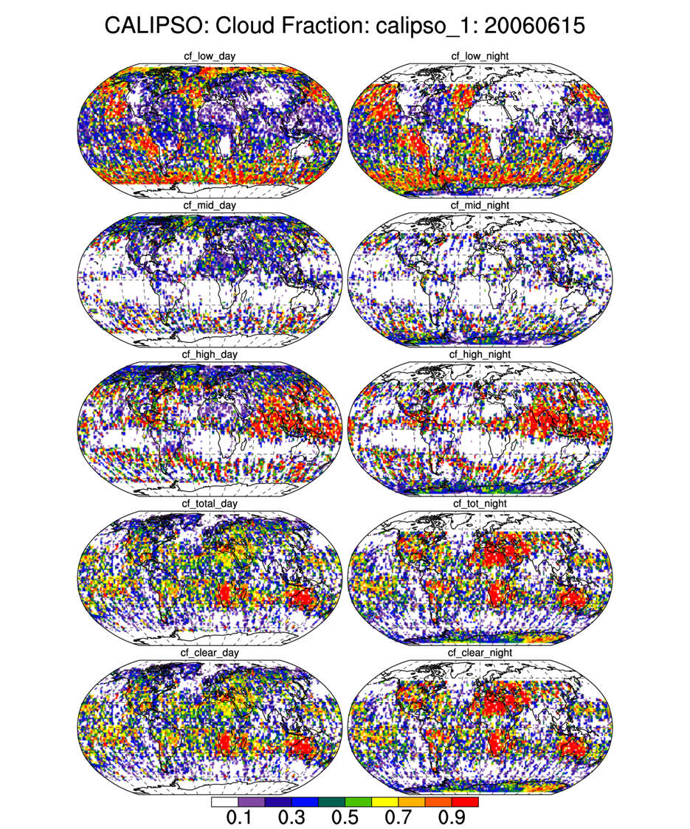
CALIPSO was launched on April 28, 2006 to study the impact of clouds and aerosols on the Earth's radiation budget and climate.
It flies in formation with five other satellites in the international "A-Train" constellation for coincident Earth observations. The CALIPSO satellite comprises three instruments, the Cloud-Aerosol Lidar with Orthogonal Polarization (CALIOP), the Imaging Infrared Radiometer (IIR), and the Wide Field Camera (WFC).
CALIPSO is a joint satellite mission between NASA and the French Agency, CNES

Slide 74
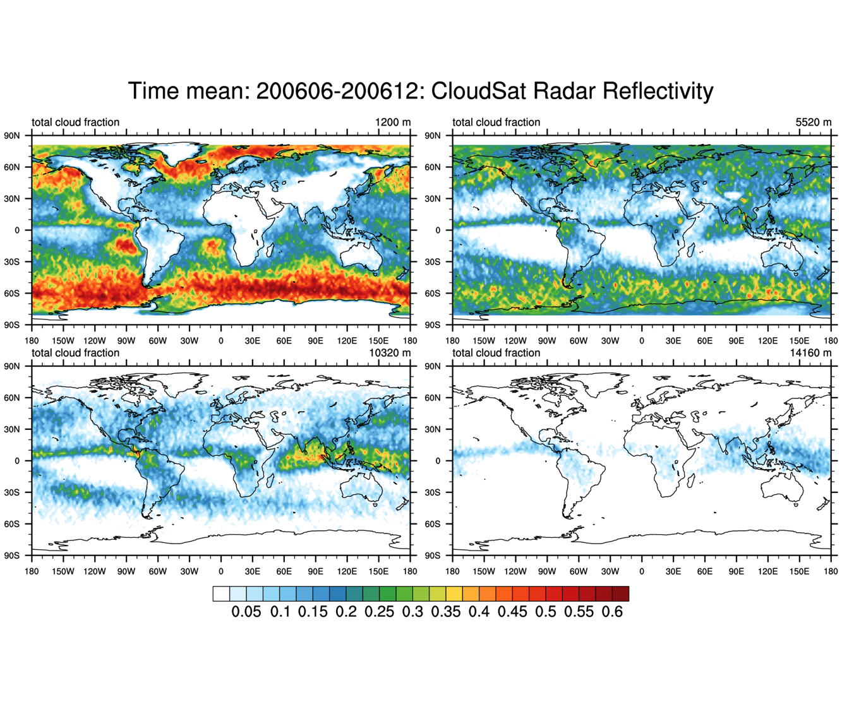
Cloudsat is a satellite mission designed to measure the vertical structure of clouds from space. The radar data produces detailed images of cloud structures which will contribute to a better understanding of clouds and climate.

Slide 75
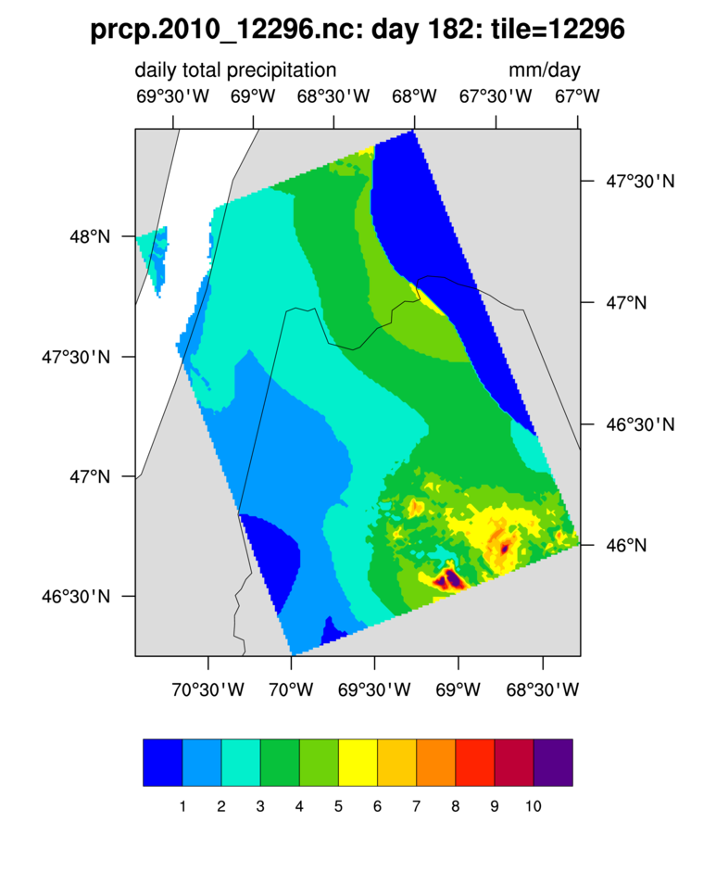
Daymet: Developed by Dr. Peter E Thornton to fulfill the need for daily climatological data necessary for plant growth model inputs, Daymet generates daily, gridded surfaces of temperature, precipitation, humidity, and radiation over large regions and takes into account areas of complex terrain.
The data are available as a suite of 2x2 degree tiles. Each tile contains 1km x 1km gridded values and is available as a netCDF file. The tile locations cover land areas from Mexico to southern Canada.

Slide 76
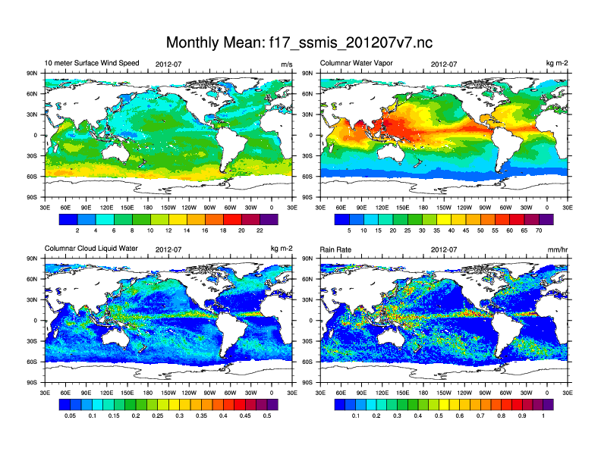
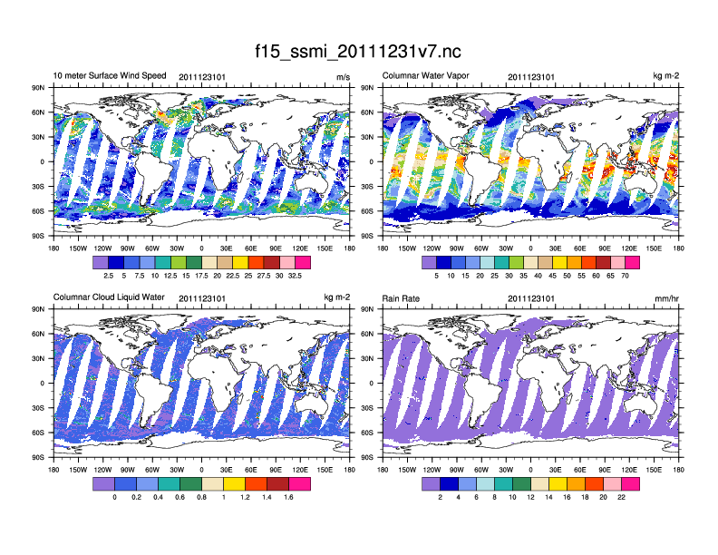
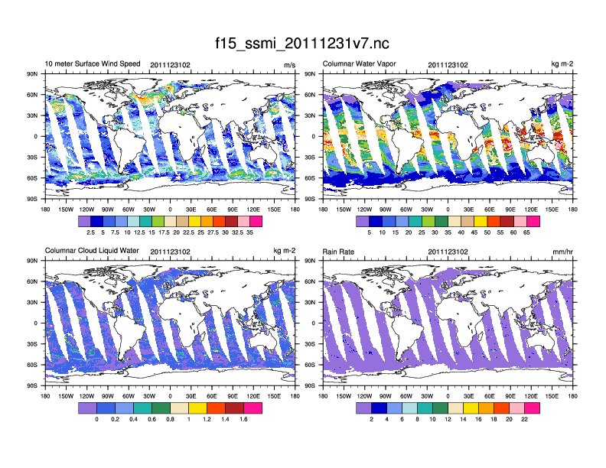
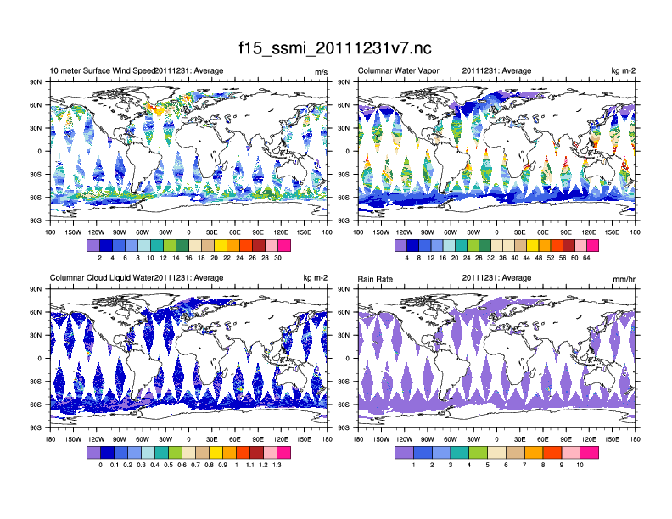
The Ocean Product Suite (v7) from Remote Sensing Systems (RSS) includes numerous data products for the SSMI/SSMIS instruments on the DMSP F08, F10, F11, F13, F14, F15, F17 polar orbiting satellites. These are part of the NASA Making Earth Science Data Records for Use in Research Environments (MEaSUREs) Program. Gridded data are available at the following temporal resolutions: daily, 3-day average, weekly average and monthly average.
The data are available from the Global Hydrology Resource Center.

Slide 77

NCL / ESMF regridding visualizations
http://www.ncl.ucar.edu/ESMF/

Slide 78
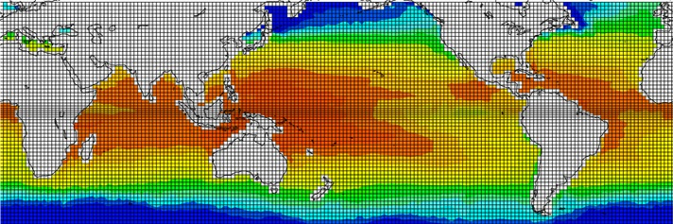
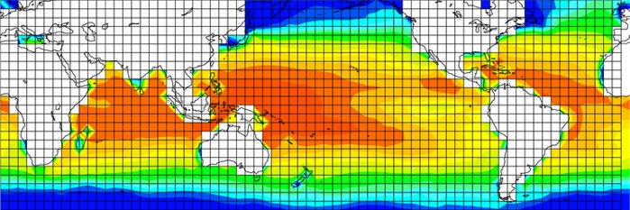
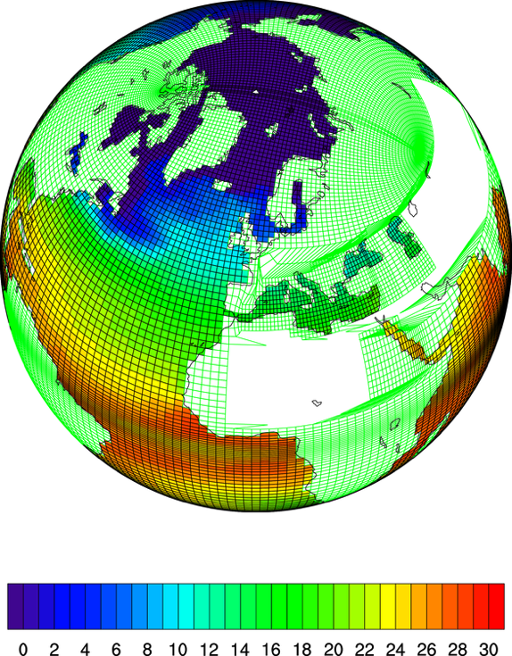
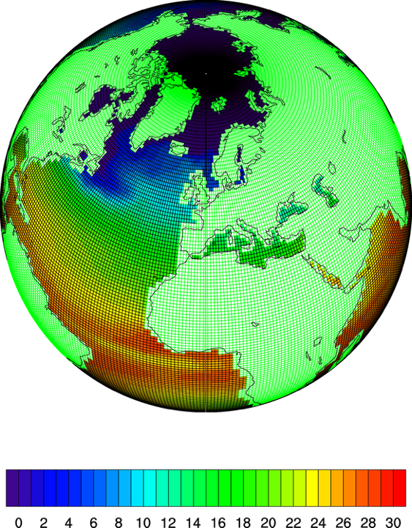
Fine resolution to coarse resolution
Curvilinear “strange” grid to regular grid

Slide 79
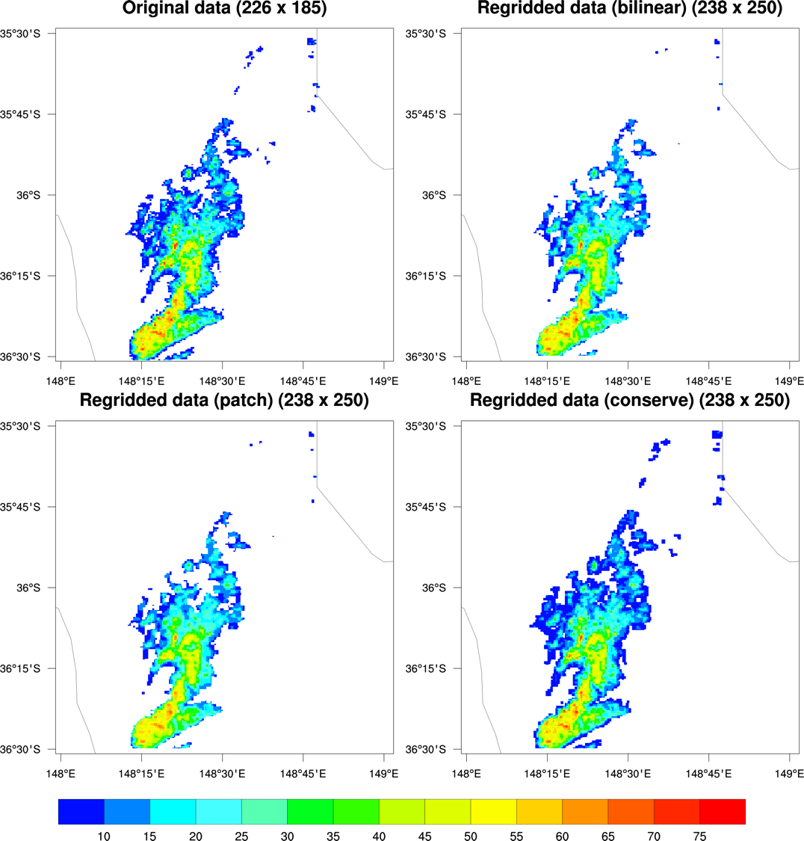
Shows the three interpolation methods available in ESMF regridding:
bilinear
patch
conserve
(nearest neighbor recently added)

Slide 80



Slide 81

curvilinear to rectilinear

Slide 82

unstructured to curvilinear

Slide 83


Fine grid to coarse grid

Slide 84

HDF4 dataset containing MODIS (Moderate Resolution Imaging Spectroradiometer) Aqua Level-3 SSTs
Original 9 km grid
0.5 x 0.5 degree grid

Slide 85
NCL visualizations of shapefile data
The ESRI Shapefile is a popular geospatial vector data format for geographic information systems software. It is developed and regulated by ESRI as a (mostly) open specification for data interoperability among ESRI and other software products.
Shapefiles describe a homogeneous set of geometrical features comprised of either points, polylines, or polygons.
Numerous (and free) shapefiles can be found by googling on the web.
Global Administrative Areas database (http://www.gadm.org) offers consistent administrative boundaries at 3 levels. The level 0 database (nations) is good to use for global or mesoscale results, level 1 is the first level of sub-national administration (typically states/provinces and territories) while level 2 offers the second level of administration and is potentially useful for high-resolution plots. The global shapefiles are large but it's possible to download individual countries separately.
http://www.ncl.ucar.edu/Applications/shapefiles.shtml

Slide 86



The three types of shapefiles supported by NCL:
Point – locations of cities,
population data, election results ☺
Line – rivers, roads, trails
Polygon – counties, lakes

Slide 87


Slide 88

You can use masking functions to remove areas of disinterest.
This shapefile data came from DIVA-GIS
http://www.diva-gis.org/gdata

Slide 89
NCL scripts for analyzing and
visualizing WRF-ARW data (WRF-NCL)
The Weather Research and Forecasting (WRF) Model is a next-generation mesoscale numerical weather prediction system designed to serve both operational forecasting and atmospheric research needs.
http://www.mmm.ucar.edu/wrf/OnLineTutorial/Graphics/NCL/

Slide 90

WRF-ARW online tutorial is maintained by Cindy Bruyère and Abby Jaye NCAR/MMM

Slide 91



Slide 92


Slide 93

Visualization from WRF suite of NCL scripts (WRF-NCL)

Slide 94


Slide 95






Plotting all fields in a GEO_EM file
http://www.mmm.ucar.edu/wrf/OnLineTutorial/Graphics/NCL/Examples/GEO_EM/geo_em_2.htm

Slide 96


Slide 97
Other types of special visualization scripts
          Skew-T
          Meteograms
          Wind Roses
          Taylor Diagrams
          Histograms
          Evans plot

Slide 98

Skew-T graphic
Courtesy of
Dennis Shea

Slide 99

Wind roses
Courtesy of Dennis Shea, CGD
A wind rose displays the frequency (percentage) of wind directions for a specific location over a specified period of time.

Slide 100

Taylor diagram
Courtesy of Dennis Shea and Adam Phillips, CGD

Slide 101

Evans plot - Created by Jason Evans University of New South Wales.
An Evans plot is a way to visualize spatially, two variables of interest, one of which provides some measure of "importance".

Slide 102

John Ertl, FNMOC
CCMVal Workshop 2009  June 1-5, 2009

Slide 103
Visualizations contributed by users

Slide 104

NCL image courtesy of Christine Shields, CGD
Paleogeography data courtesy David Rowley, PGAP

Slide 105

Imran Nadeem, BOKU Vienna

Slide 106

Imran Nadeem, BOKU Vienna

Slide 107

Imran Nadeem, BOKU Vienna

Slide 108

Power spectra of two timeseries:
model derived and observations.
Courtesy of
Adam Phillips, NCAR CGD

Slide 109

Image courtesy of
Jeff Yin, CGD

Slide 110

Clouds, precipitation, and near surface air temperature in a satellite view.
Center for Climate Systems Modeling
Institute for Atmospheric and Climate Science
Thierry Corti (C2SM)
Urs Beyerle (IACETH)
Erich Fischer (IACETH)
Zürich, Switzerland
Data: 430 GB
Time evolution: 2 years
Time resolution: 1 hour
Timesteps: 17,250

Slide 111

Finite volume one degree data from CCSM4.
Gary Strand, NCAR/NESL

Slide 112

Connectivity graphs from a biological neural network model.
Trevor Law, Univ of California @ Irvine

Slide 113

NCL script contributed by Qin Rui of the Beijing Weather Modification Office.

Slide 114

Image courtesy of Julie Arblaster
Bureau of Meteorology, University of Melbourne

Slide 115

Graphic by
Yi Wang, PNNL

Slide 116

Aiguo Dai (NCAR Earth System Lab)
Dai, A., 2001, Drought under global warmming: A review. Wiley Interdisciplinary Reviews: Climate Change, 2, 45-65
Data from the WCRP CMIP3 multi-model dataset.
Image generated by Tim Scheitlin (NCAR/CISL) using NCL, Blender, and FinalCut Pro.

Slide 117

Based on a visualization
of Adam Phillips, CGD

Slide 118


Images courtesy of
Jonathan Vigh, NCAR/ASP
Tropical Cyclone Guidance Project
http://www.ral.ucar.edu/hurricanes/

Slide 119


Slide 120


Slide 121

Science by Synte Peacock, NCAR/CGD
This image suggests that Wolverine habitat is likely to warm dramatically if society continues to emit large amounts of greenhouse gases.
Image generated by Tim Scheitlin (NCAR/CISL) using NCL, Blender, and FinalCut Pro.

Slide 122

Ufuk Turuncoglu, ITU
Turkey Climate Change Scenarios

Slide 123

John Fasullo, NCAR/CGD

Slide 124
Overview
Introductions
Audience survey
Introduction to data formats and metadata
Introduction to NCL
  File input/output – demo
  Computations – demo
  Visualizations – demo
NCL visualization gallery
Other projects and collaborations we are part of
User contributed software and projects
“No one tool does it all”
Challenges

Slide 125


PyNIO and PyNGL
Python modules based on a subset
of NCL’s capabilities
PyNIO
Reads and writes same data formats as NCL
Has special syntax for complex data subsetting (not available in NCL)
PyNGL
Same publication-quality graphics as NCL
Utilizes existing Python modules and development tools (NumPy, swig, f2py, ScientificPython)
Some climate-specific computations
http://www.pyngl.ucar.edu/

Slide 126

What is Python?
Why Python?
Python is a programming language that lets you work more quickly and integrate your systems more effectively. You can learn to use Python and see almost immediate gains in productivity and lower maintenance costs.
http://www.python.org
Demand for high-quality 2D visualization
Capitalize on the work of others
Collaboration opportunities
Mainstream language - wider audience
Contribution to Python community
Open source

Slide 127
Python is really picking up in the climate, atmospheric, and oceanic sciences
PyAOS (Python for the Atmospheric and Oceanic Sciences) – group that has a email list and is collaborating on a specialized suite of AOS computational functions
Python courses being taught at annual AMS (American Meterological Society) meeting
http://ocefpaf.github.io - blog for python and marine sciences
SciPy 2013 had a mini AOS syposium
Numerous Python modules for dealing with data formats

Slide 128
Comparing PyNGL/PyNIO and NCL scripts
PyNGL/PyNIO
NCL
import Ngl, Nio
# Open the NetCDF file.
nf = Nio.open_file("mtemp.cdf","r")
# Get lat/lon/temperature variables.
lat = nf.variables["lat"][:]
lon = nf.variables["lon"][:]
T = nf.variables["t"][0,:,:]
# Open a PS workstation.
wks = Ngl.open_wks("ps","mecca")
# Contour & scalar field resources.
res = Ngl.Resources()
res.sfXArray = lon
res.sfYArray = lat
res.cnFillOn = True
# Draw contour plot.
contour = Ngl.contour(wks,T,res)
Ngl.end()
load "gsn_code.ncl"
begin
; Open the NetCDF file.
nf = addfile("mtemp.cdf","r")
; Get lat/lon/temperature variables.
lat = nf->lat
lon = nf->lon
T = nf->t(0,:,:)
; Open a PS workstation.
wks = gsn_open_wks("ps","mecca")
; Contour & scalar field resources.
res = True
res@sfXArray = lon
res@sfYArray = lat
res@cnFillOn = True
res@lbPerimOn = False
; Draw contour plot.
contour = gsn_contour(wks,T,res)
end

Slide 129








3-year joint DOE project with Argonne, Sandia, and Pacific Northwest National labs and UC-Davis to develop parallel analysis tools and new visualization techniques for ultra-large climate datasets.
pNetCDF
MOAB
High focus on Community Earth System Model data
Special (and fast) algorithms for calculating vorticity/divergence on HOMME grids
ParGAL (Parallel Gridded Analysis Library) - will vastly improve the speed of climate data analysis compared to the current serial tools.
ParNCL – NCL with file I/O and computational components parallelized
http://trac.mcs.anl.gov/projects/parvis/wiki

Slide 130





regridding software
built into NCL
Mohammad Abouali, SIParCS intern
Dave Brown & Mary Haley, mentors
Robert Oehmke, collaborator
ESMF Group, NOAA/ESRL/NESII
Regridding is the process of interpolating data from one grid (rectilinear, curvilinear, unstructured) to another while preserving the qualities of the original data.
ESMF regridding has multiple interpolation methods;
a crucial feature for climate model intercomparison.
  http://www.ncl.ucar.edu/Applications/ESMF.shtml

Slide 131



NCAR Viewer (NV)
An interactive tool in early development and testing that specializes in quick look and cross sectional views of data
Can quickly browse files and choose variables to plot
Provides a “three-dimensional” viewspace where you can rotate and zoom image
Handles many of NCAR’s major models (CAM, POP, WRF, MPAS)

Slide 132






VAPOR
Visualization aided data analysis for the earth sciences
A domain-focused, open source visual data analysis package targeted for researchers in the atmospheric, oceanic, and related sciences
By leveraging a wavelet-based intelligent data storage model VAPOR enables highly interactive exploration of the largest numerical simulation outputs using only commodity computing resources.
A community-driven feature set guided by an international steering committee of computational scientists working in a broad gamut of earth science disciplines
Metrics:
  ~5000 new users since January, 2011
  ~4000 unique VAPOR web site visitors per month in 2013 (up from 1000 in 2012, and 500 in 2011)
  20 scholarly citations for VAPOR in 2012, and 7 to date in 2013
What makes VAPOR unique?
It is developed specifically to meet the needs of the NCAR science communities
Due to its intelligent data model VAPOR affords interactive exploration of the largest simulation outputs using only commodity computing resources
It combines qualitative visualization with quantitative data operators to provide a comprehensive data exploration environment (not just pretty pictures)
I. Grooms, et al. 2010
www.vapor.ucar.edu
S. Wedemeyer-Böhm, et al. 2012
VAPOR is funded in part through U.S. National Science Foundation grants 03-25934 and 09-06379, a TeraGrid GIG award, and the Korean Institute for Science and Information Technology
M. Shapiro; S. Grønås, 2012
L. Orf, 2009

Slide 133


Radar reflectivity derived from a 500m Weather Research Forecast simulation of Hurricane Sandy, the largest NWP model ever run [Johnsen 2013]
DBZ computed from original data (203 GBs)
DBZ computed from variables compressed
10:1 (20.3 GBs)

Slide 134








A sampling of gallery contributions from VAPOR users
BIOLOGY
Cristina Siegerist, LLNL
TURBULENCE
Mark Rast, NCAR
STELLAR ASTRONOMY
Paolo Padoan, UCSD
WILDFIRES
Janice Coen, NCAR
SEVERE STORMS
Mel Shapiro, NCAR
EDUCATION
TOY Workshop Students
WIND ENERGY
Kenny Gruchalla, NREL
HAZARDOUS WEATHER
Leigh Orf, Central Michigan U.

Slide 135
Supported file formats & model outputs
  Climate Forecast (CF) convention NetCDF files
    MOM4
    POP
    ROMS
  WRF outputs
  NetCDF (structured grid data)
  Flash AMR
  Raw (binary) data
Features
  GPU enabled volume rendering and isosurfaces
  Cutting planes
  Flow visualization
    Streamlines (steady flows)
    Pathlines (unsteady flows)
    Image Based Flow Vis.
    Hedgehog plots (wind barbs)
  Geo-referenced data support
  NumPy/SciPy calculation engine
  Key-frame animation
  Quantitative analysis
  Probes
  Statistics

Slide 136




NCL and GoogleEarth™
Part of a summer intern project in CISL
Google Earth™ offers a highly intuitive and usable visualization environment for displaying Earth science data in its geospatial context.
A library of NCL routines has been developed to enable earth scientists to easily convert geo-referenced model output and other data to KML for display in Google Earth.

Slide 137

Tropical Cyclone Guidance Project http://www.ral.ucar.edu/hurricanes/
Each individual storm page features the latest plots of model guidance and intensity forecast aids for that storm, as well as other diagnostic and observational information.

Slide 138
Climate Data Guide http://climatedataguide.ucar.edu
An insider’s view of data strengths and limitations.
“Like an insider's guidebook to an unexplored country, the Climate Data Guide provides the key insights needed to select the data that best align with your goals, including critiques of data sets by experts from the research community.”
The Climate Data Guide is funded by the U.S. National Science Foundation.

Slide 139
Overview
Introductions
Audience survey
Introduction to data formats and metadata
Introduction to NCL
  File input/output – demo
  Computations – demo
  Visualizations – demo
NCL visualization gallery
Other projects and collaborations we are part of
User contributed software and projects
“No one tool does it all”
Challenges

Slide 140



Another NCL/GoogleEarth™ project
kmlncl
NCL library for creating KML visualizations for Google Earth and Google Maps
Ryan Pavlick
Jet Propulsion Laboratory
With contributions from
Álvaro M. Valdebenito
Norwegian Meteorological Institute
Aditya R. Kartadikaria
Frontier Research Center
for Global Change Japan Agency for Marine-Earth
Science and Technology

Slide 141


http://www.ncl.ucar.edu/Applications/cosmo.shtml
This page describes various ways to visualize COSMO model data. COSMO is a non-hydrostatic limited-area atmospheric prediction model operated and developed by a international consortium of weather services. Oliver Führer from MeteoSwiss provided all the materials for these examples.

Slide 142




Various contributions by users
Suites of computational routines
  Sea water equations, WRF helicity, ocean diagnostics
Graphical examples
  Schematic map of the Arabian Sea, “Quiver” plots, bathymetry of an ocean model, METAR data, pie charts over a map

Slide 143
























Various contributions by users (cont’d)
Editor enhancements (emacs, vi, gedit, etc)
Over 100 new color tables converted from other packages like GMT, SVG, matplotlib, and ncview

Slide 144
Overview
Introductions
Audience survey
Introduction to data formats and metadata
Introduction to NCL
  File input/output – demo
  Computations – demo
  Visualizations – demo
NCL visualization gallery
Other projects and collaborations we are part of
User contributed software and projects
“No one tool does it all”
Challenges

Slide 145


No one tool does it all…
VAPOR – Visualization and Analysis Platform for Ocean, Atmosphere, and Solar Researchers. 3D data visualizer, specializing in ultra-large datasets
http://www.vapor.ucar.edu
ncview – interactive, quick look at NetCDF data
http://meteora.ucsd.edu/~pierce/ncview_home_page.html
GrADS – Grid Analysis and Display System
http://www.iges.org/grads/
IDV – Interactive Data Viewer
http://www.unidata.ucar.edu/software/idv/

Slide 146


No one tool does it all…
NCO, CDO – command line operators for doing efficient manipulations and/or calculation across multiple files
http://nco.sourceforge.net
https://code.zmaw.de/projects/cdo
R – software environment for statistical computing and
graphics
http://www.r-project.org
convert – part of free ImageMagick suite of tools; great for converting from/to formats like png, PS, PDF, jpeg, gif, etc
http://www.imagemagick.org/

Slide 147



















NCL Data Analysis and Visualization Workshops
Primarily for climate and weather researchers
3.5 days with lectures and intensive hands-on lab sessions
Co-taught by NCAR scientific and engineering staff
Students encouraged to BYOD (Bring Your Own Data)
Free for all students; funding provided for EPSCoR and MSI students
Workshops given locally and at universities and research institutions world-wide
67 workshops taught to 1023 students since February 2000

Slide 148




NCL Workshop, July 1-5, 2013
Universidade Federal do Rio Grande do Norte
in the city of Natal, Rio Grande do Norte in Brazil
Taught by Guilherme Martins, a meteorology doctoral student at the Graduate Program in Earth System Science (CST) of the National Institute for Space Research (INPE)

Slide 149
NCL Workshops
So far in 2013:
  Boulder, January
  University of Albany, May
  Boulder, June
  Brazil, July
Three more scheduled
  Harvard, September 2013
  Max Planck Inst. for Meteorology, Hamburg, November 2013
  University of Maine, April 2014

Slide 150
Overview
Introductions
Audience survey
Introduction to data formats and metadata
Introduction to NCL
  File input/output – demo
  Computations – demo
  Visualizations – demo
NCL visualization gallery
Other projects and collaborations we are part of
User contributed software and projects
“No one tool does it all”
Challenges

Slide 151

BIG (HAIRY) DATA

Slide 152
Challenges
Data is becoming far more complex, requires special understanding of new structures
Data is large and being generated quickly. Current tools cannot keep up with demand.
Systems that we program on are more complicated, more than one way to do “parallelism”. Requires team of experts!
These special cases are requiring software to be specialized. Less focus on “general” software
People need to compare data one same grids: requires special regridding software.

Slide 153

Thank you. . .any questions?
Mary Haley, haley@ucar.edu
http://www.ncl.ucar.edu
http://www.pyngl.ucar.edu
NCAR Mesa Lab in Boulder, CO

Slide 154
Hundreds of application examples
Click on category of interest

Slide 155
Click on thumbnail to see larger image
Click on script name to see code

